Slide 1
Weather Maps
How do weather maps help predict the weather?

Slide 2
Meteorologist
Meteorologists are_____________________________
_____________________________________________________
_____________________________________________________
_____________________________________________________
_____________________________________________________
Notes:
Teacher writes definition of a meteorologist with class. Meteorologists are scientists who study the atmosphere. They examine its effects on the environment, predict the weather, or investigate climate trends.

Slide 3
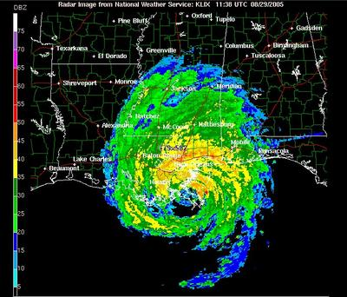
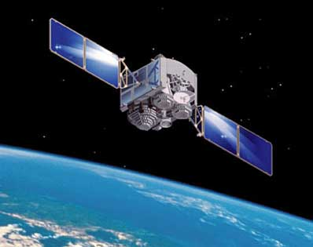
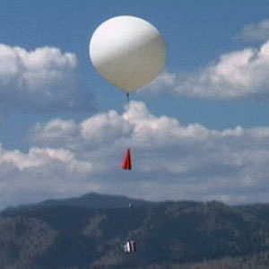
Meteorologist Tools
Notes:
Teacher labels tools on white board and students on their notes.
Picture 1: Statellite
Picture 2: Radar
Picture 3: Weather Balloon

Slide 4
These tools measure…
Temperature
Wind
Moisture
Air Pressure

Slide 5
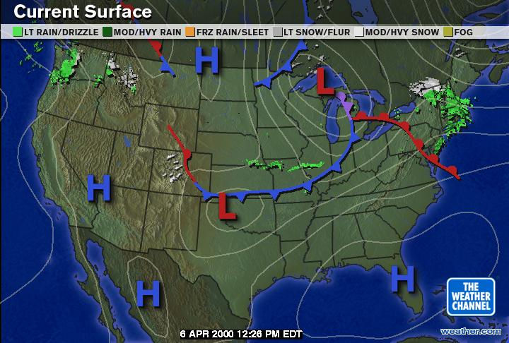
Meteorologists use maps to predict weather

Slide 6
What do you know about high pressure and low pressure?
High Pressure
Low Pressure
High pressure is caused by_______________________
____________________________
____________________________
High pressure causes
___________________weather.
Low pressure is caused by_______________________
____________________________
____________________________
Low pressure causes
__________________weather.
Notes:
Have students work in table groups or pairs to fill out information on chart about what they remember

Slide 7
Where are high pressure and low pressure systems on this map? Label them.
High Pressure
Low Pressure
Notes:
Have students work in groups or pairs to label map. Then show answers on Power Point to compare answers.

Slide 8
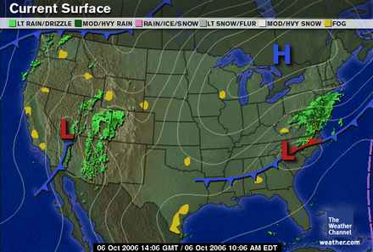
Weather Systems
In the United States air pressure systems move from left to right. Look at this map.
Where will the low pressure system over Nevada go to next?
Notes:
Teacher has students talk to a partner.

Slide 9
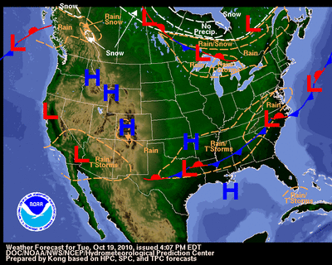
What is the weather going to be like?
Notes:
Teacher asks students questions about the weather in different regions.
What is the weather going to be like in California? Stormy.
What is the weather going to be like in Colorado? Nice weather.
Misconception alert: Students tend to think of stormy weather as cold and nice weather as hot. Even though air pressure is made by cold and warm air it does not make cold or warm weather. Other factors affect temperature.

Slide 10
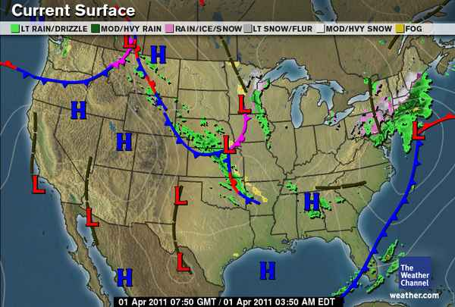
Its your turn. Look at this map and make predictions about the weather.

