Slide 1
Types of Interactions

Slide 2
Interactions with the Environment
Limiting Factors- A resource (food, water, living space) that is so scarce that it limits the size of the population.
Carrying Capacity- The largest population that an environment can support.

Slide 3
Interaction Between Organisms
Competition-When two or more individuals or populations try to use the same resources such as food, water, shelter, space, or sunlight.

Slide 4
Predators and Prey
Prey- is the organism that is eaten.
Predator- is the organism that eats the prey.

Slide 5
Predator and Prey Adaptations
Camouflage- blending in with the background.
Defensive Chemicals – animals that defend themselves with chemicals e.g. bees, ants, wasps, poison arrow frog, skunk.
Warning Coloration – An animals chemical weapon is often advertised by warning colors. The most common colors are bright shades of red, yellow, orange, black and white.

Slide 6
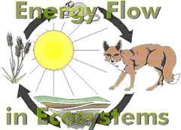

Slide 7
Producers
Organisms that use sunlight to make food.
Most producers are plants, but algae is also a producer.

Slide 8
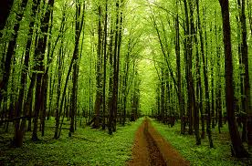
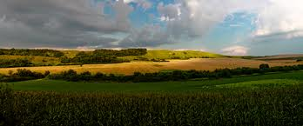
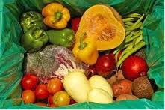
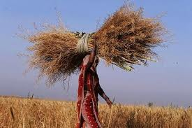

Slide 9
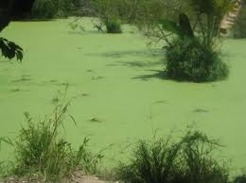
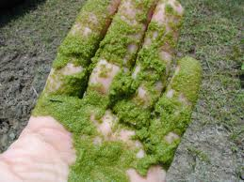
Algae

Slide 10
Consumers
Consumer – Organisms that eat other organisms
They cannot use the sun to make their own food like producers can.
They must eat producers and other animals to get their energy.

Slide 11
Three Types of Consumers
Herbivore – is a consumer that eats plants.
Carnivore – is a consumer that eats animals.
Omnivore – is a consumer that eats both plants and animals.
Scavengers – are omnivores that eat dead plants and animals.

Slide 12
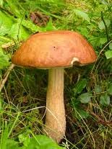
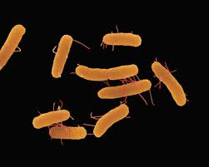
Decomposers
Organisms that get energy by breaking down dead organisms.
Bacteria and fungi

Slide 13
