Slide 1
Components of the universe
The Universe

Slide 2
Stars
Object in space that gives off its own light
All sizes
Closest star to Earth is the Sun
Sun is 1,392,000 km in diameter
Giant stars are 10-100 x larger than the Sun
White Dwarfs are smaller than Earth
Neutron stars could be as small as your community

Slide 3
Composition of Stars
Made up of 2 gases
Hydrogen (H) and Helium(He)
Gases burn different colors
Scientist determine what gas the star is made of by the color that it burns.
Red and yellow colors have cooler temperatures
Blue and white are HOT

Slide 4
Spectroscope
Instrument used to study stars
Spectrum- band of color produced when white light passes through a prism
Scientist/Astronomers use information from the spectroscope to determine the star’s composition(what it’s made of) and its temperature.

Slide 5
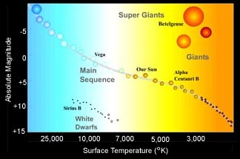
Main Sequence Stars
90% of Stars that are:
hot, blue or white, bright stars
average temp, yellow stars (Sun)
cool, red or orange, dim stars

Slide 6
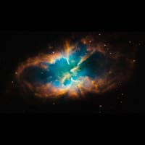
How Stars Form
NEBULA – (Birth place) stars begin as a large cloud of gas and dust.
As the particles move closer together, temperatures rise, and light and heat are released the star is born.

Slide 7
Star’s Motion
Stars appear to move across the sky is due to Earth’s rotation
Stars do move in space, however, because of the distance from Earth we can’t see their movement

Slide 8
Planetary Systems
Planet- is a large ball-shaped object that moves around a star in a fixed path.
Planets , unlike stars, do not give off their own light and heat.
Solar System- The 8 planets that revolve around our star, the sun.
Planetary Systems- A star and its planets
There are many planetary systems, but do any of these systems contain planets similar to Earth?

Slide 9
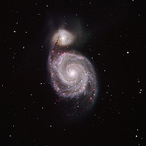
Galaxies: a huge family of stars, gas, and dust held together by gravity.
Galaxies have 3 main shapes
Spiral Galaxies – have a thick bunch of stars in the middle surrounded by stars arranged in spiral arms.

Slide 10
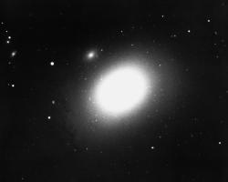
Elliptical Galaxies – shaped like balls or flat discs. Many are football shaped, but some are round.
Round shape
Football shaped

Slide 11
Irregular Galaxies – includes most of those galaxies that don’t fit into the other categories.
They have many different shapes and are smaller than the spiral and elliptical galaxies.

Slide 12
Milky Way Galaxy (OUR HOME)
Spiral shaped galaxy
Is the galaxy that you and I live in.
Our sun is only one star out of one trillion in our galaxy.
The stars you can see at night are part of the Milky Way Galaxy.

Slide 13
Black Holes
A region of space in which gravity is so strong that nothing can escape its pull.
It is called black because even light is pulled by its gravity.
It is a hole because it is an area into which things seem to disappear.
It is a one way street, which objects travel inward, but nothing comes back out!
QUESTION I f you can’t see it how do scientist know it exists?

Slide 14
Beyond the Galaxies
Quasars -are powerful, active galaxies far beyond our own.
Quasars are some of the most distant objects humans have ever seen in space.
Intergalactic Matter- Materials in space that are not part of galaxies.
These areas are believed to contain extremely cold, dustlike materials.

Slide 15
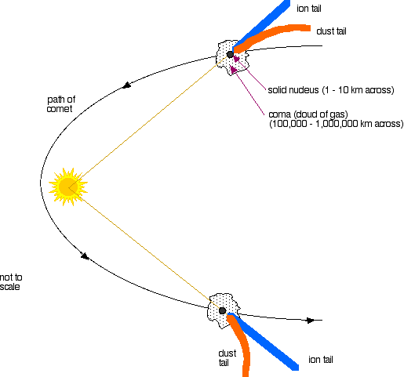
Comets -a small body of ice, rock,& cosmic dust loosely packed together.

Slide 16
Comets = Dirty Snowball

Slide 17
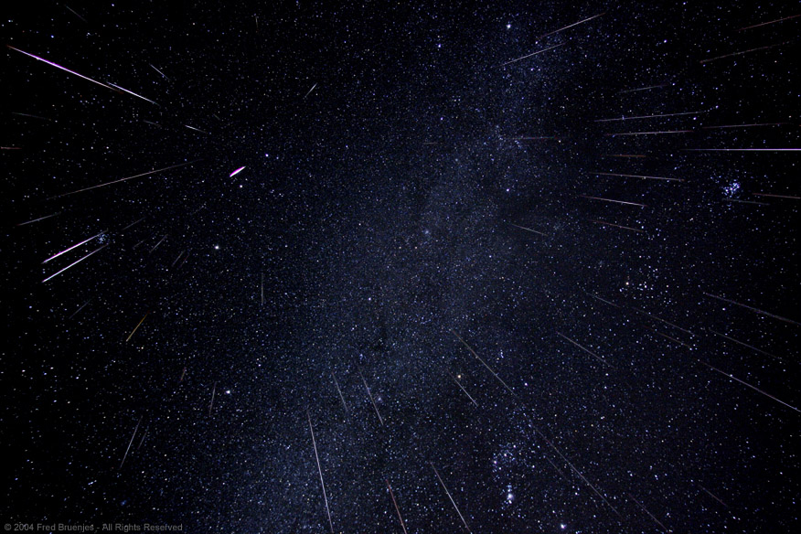
Meteors Shooting or Falling Stars
Meteoroids are small rocky bodies that revolves around the sun
Meteoroids are called Meteors when they enter Earth’s Atmosphere
Meteors usually burn up before striking the ground
Lots of meteors that burn at one time are called “Meteor Showers”

Slide 18
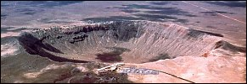
Meteorite Hits Right here on Earth
A meteor that doesn’t burn up and hits the surface of Earth or any other object becomes a Meteorite.
Probably pieces of an Asteroid or particles from a Comet’s Tail
Craters are left on the surface after the impact
Arizona

Slide 19
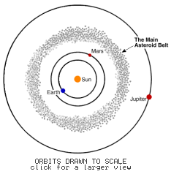
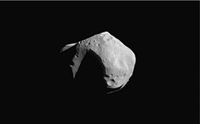
Asteroids
Asteroids are rocky and metallic objects that orbit the Sun but are too small to be considered planets.
Asteroid Belt is located between Mars and Jupiter

