Slide 1
Technology and Society
Intended and Unintended Consequences

Slide 2
Intended Benefits
A positive purpose for which a technology is designed to be used.
Cars allow people to travel many miles in short periods of time.
Nuclear plants provide a source of power.

Slide 3
Unintended Consequences
Have a negative impact on society and lowers the quality of life.
Pollution, global warming, car accidents, parking lots, nuclear waste

Slide 4
Unintended Consequence

Slide 5
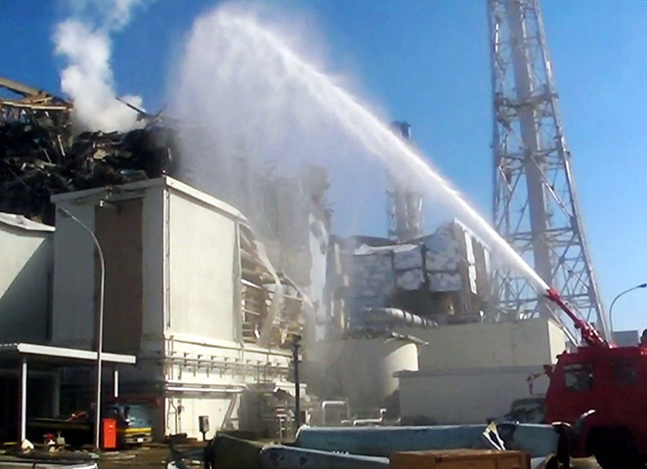
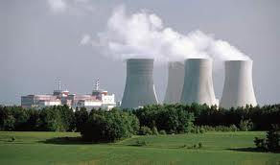

Slide 6
