Slide 1
Photosynthesis & Cellular Respiration
Opposite Processes
In the Carbon Cycle

Slide 2
Title Page
Photosynthesis
(Done in a Chloroplast)

Slide 3
Reactants Products
6CO₂ + 6H₂O + Sunlight = C₆H₁₂O₆ + 6O₂
(ATP)

Slide 4
Reactants Products
6 + 6 + = Glucose + 6
Carbon Water Light (Sugar) Oxygen
Dioxide Molecules Energy
(ATP)

Slide 5
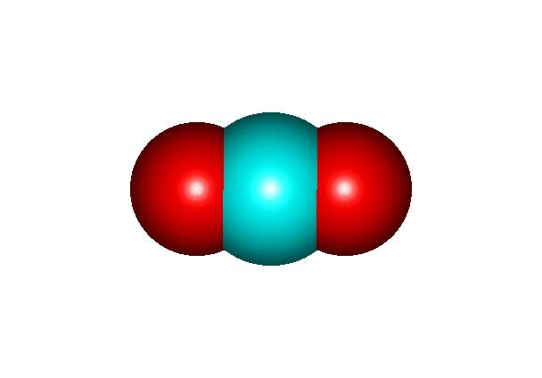
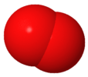
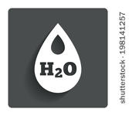
Reactants Products
=
6 CO₂ + 6H₂O + Sunlight/ATP = Glucose + 6O₂

Slide 6
Title Page
Cellular Respiration
(Done in the Mitochondria of all cells)

Slide 7
Reactants Products
C₆H₁₂O₆ + 6O₂ = 6CO₂ + 6H₂O + ATP
Sunlight

Slide 8
Reactants Products
Glucose + 6 = 6 + 6 + (Sugar) Oxygen Carbon Water Light
Dioxide Molecules Energy
ATP

Slide 9
Reactants Products
=
Glucose + 6O₂ = 6 CO₂ + 6H₂O + Sunlight/ATP

