Slide 1
Two parts in an Environment

Slide 2
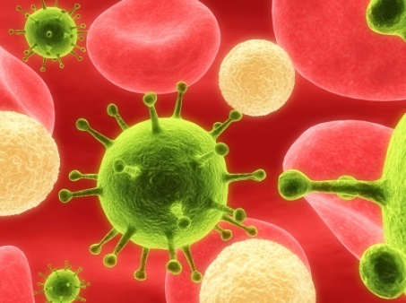

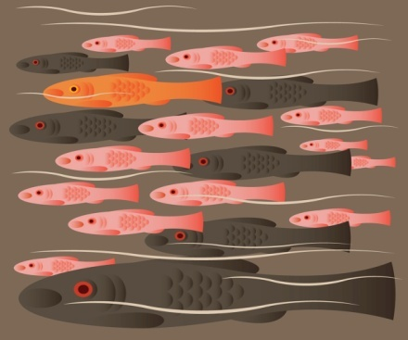
Biotic(living) parts of an environment. The organisms that live together and interact with one another.

Slide 3

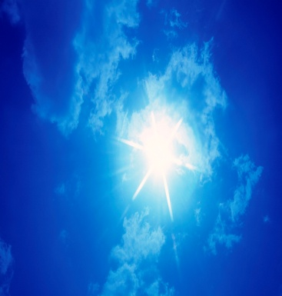
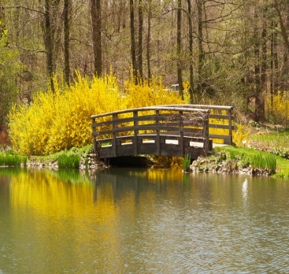

Abiotic(nonliving) Factors
Nonliving Factors: Air, Water, Soil,
Sunlight, Temperature, Climate, Wind

Slide 4
Biotic Living
Abiotic Nonliving

Slide 5
Air = Atmosphere
4 Components
1. Nitrogen 78%
2. Oxygen 21%
3. Argon 0.94%
4. Carbon Dioxide 0.03%

Slide 6
Water
Major ingredient of all cells.
Makes up 50 to 95% of all organisms.

Slide 7
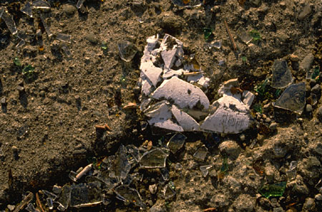
Soil made up of minerals, rock particles, remains of dead organisms, water, and air

Slide 8
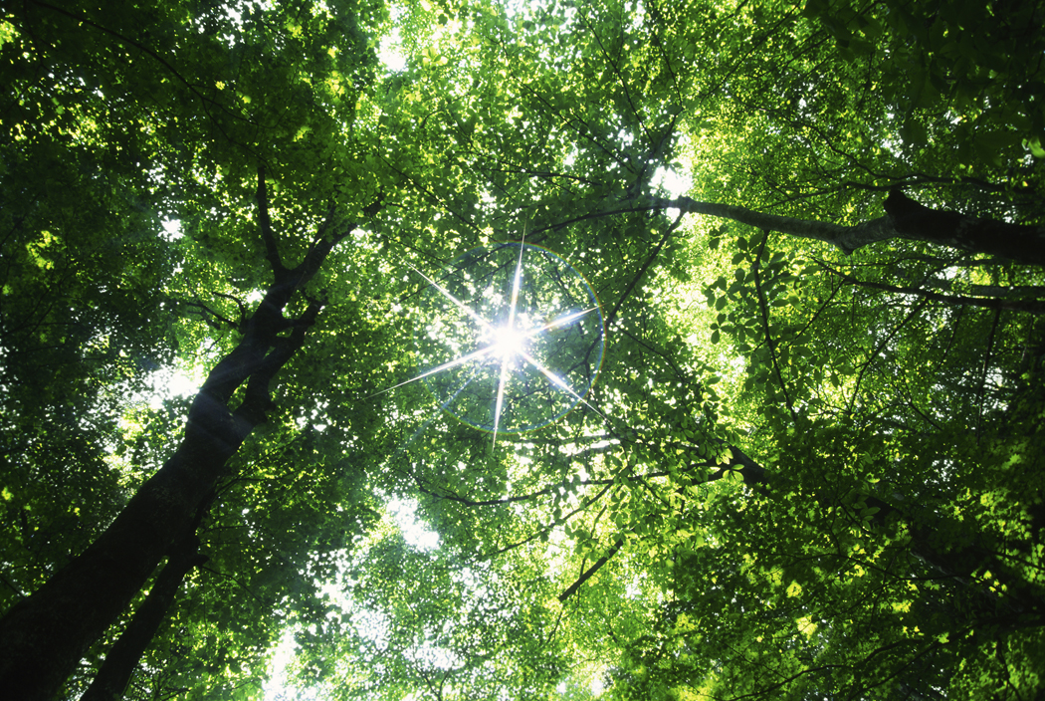
Sunlight
Source of energy for most life.
Producers have to have Sunlight for Photosynthesis to take place.

Slide 9
Temperature
Is affected by the warmth of the sun.
An organisms’ body temperature should range between 0 to 50 degrees C.
Latitude – closer to equator warm the temperature. Farther away from equator the cooler the temperature.
Elevation – Higher in the atmosphere the cooler the temp. Closer to sea level the warmer the temp.

Slide 10
Climate
Average weather conditions over time including temp, precipitation, and wind
Two most important components of a climate for living organisms are Temperature and Precipitation.

Slide 11
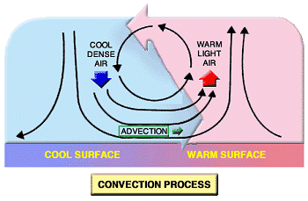
Wind
Heat energy from the Sun causes wind.

Slide 12
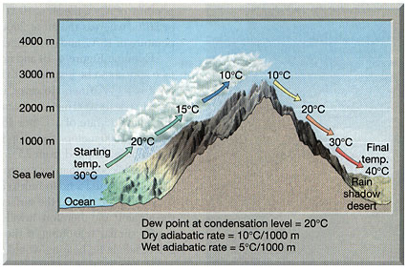
Rain Shadow Effect

