Slide 1
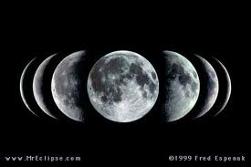
Moon Phases

Slide 2
Why Does the Moon Change Shape?
Exactly one half of the moon is normally lit by the sun.
As the moon orbits Earth we see different amounts of the half that is lit by the sun.
The different shapes we see are called the moon’s phases.
The length of time it takes the moon to make one full revolution around the Earth is called a lunar cycle.(29.5 days)

Slide 3
Waxing Phases
Waxing – When the shape that we see gets larger. The moon is growing brighter with light. The light is on the right.
New Moon
Waxing Crescent
First Quarter
Waxing Gibbous
Full Moon

Slide 4
New Moon

Slide 5
Waxing Crescent

Slide 6
First Quarter

Slide 7
Waxing Gibbous

Slide 8
Full Moon

Slide 9
Waning Phases
Waning- When the shape we see gets smaller. The moon is growing darker. Light on left.
Waning Gibbous
Third Quarter /Last Quarter
Waning Crescent

Slide 10
Waning Gibbous

Slide 11
Third/Last Quarter

Slide 12
Waning Crescent

Slide 13
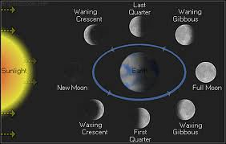
Lunar Cycle

Slide 14
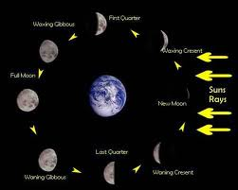
Lunar Cycle

Slide 15
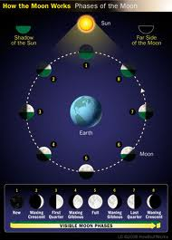
Lunar Cycle

