Slide 1
Inquiry 1 & 2 Review
Inquiry 1 Design a simple experimental procedure with an identified control and appropriate variables.
Inquiry 2 Select tools and procedures needed to conduct a moderately complex experiment.

Slide 2
What is this science tool? What is this tool used for?

Slide 3
What is this science tool? What is this tool used for?

Slide 4
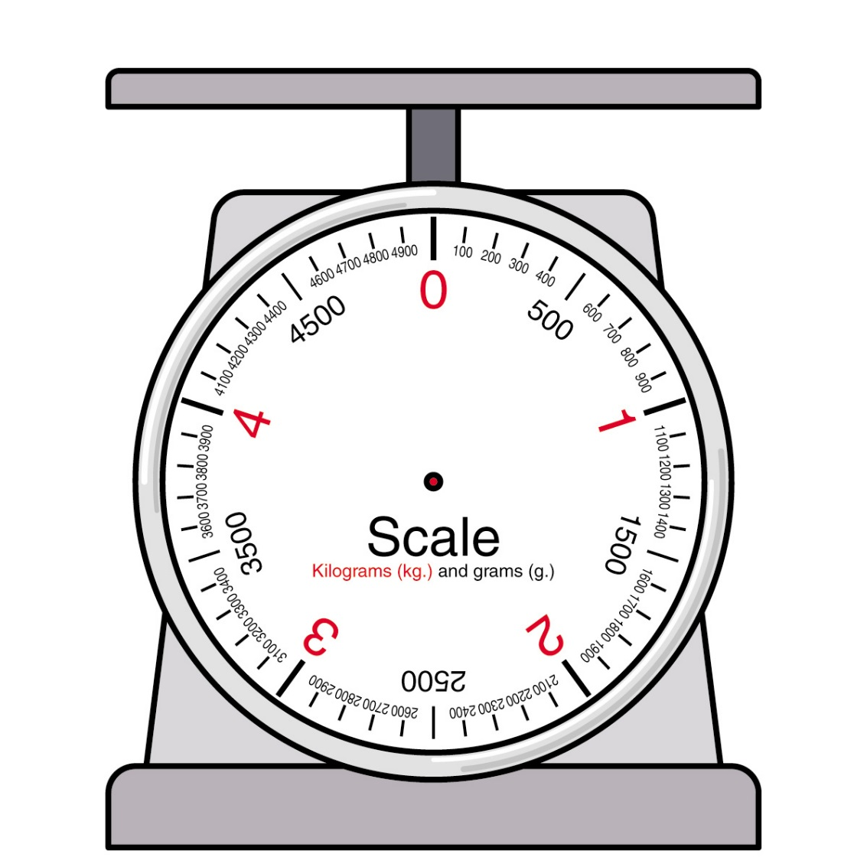
What is this science tool? What is this tool used for?

Slide 5
What is this science tool? What is this tool used for?

Slide 6
What is this science tool? What is this tool used for?

Slide 7
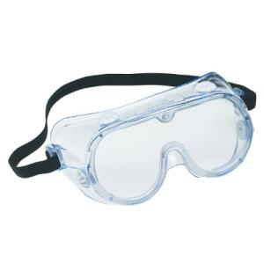
What is this science tool? What is this tool used for?

Slide 8
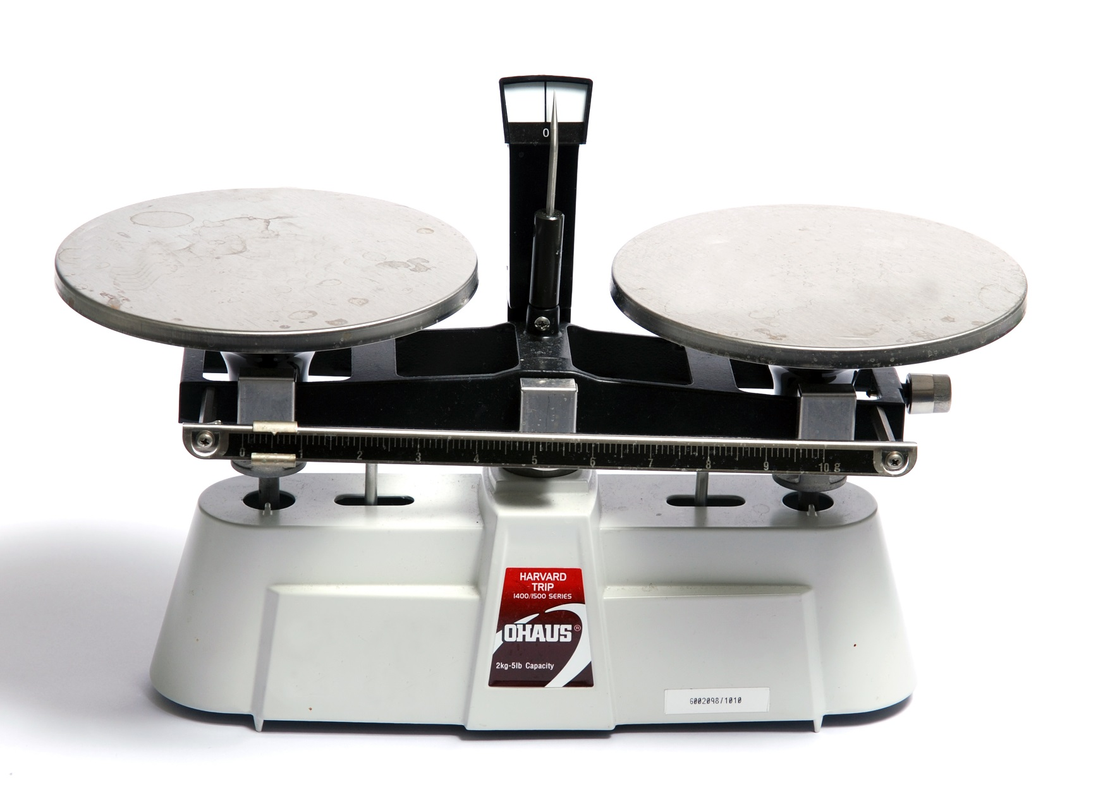
What is this science tool? What is this tool used for?

Slide 9
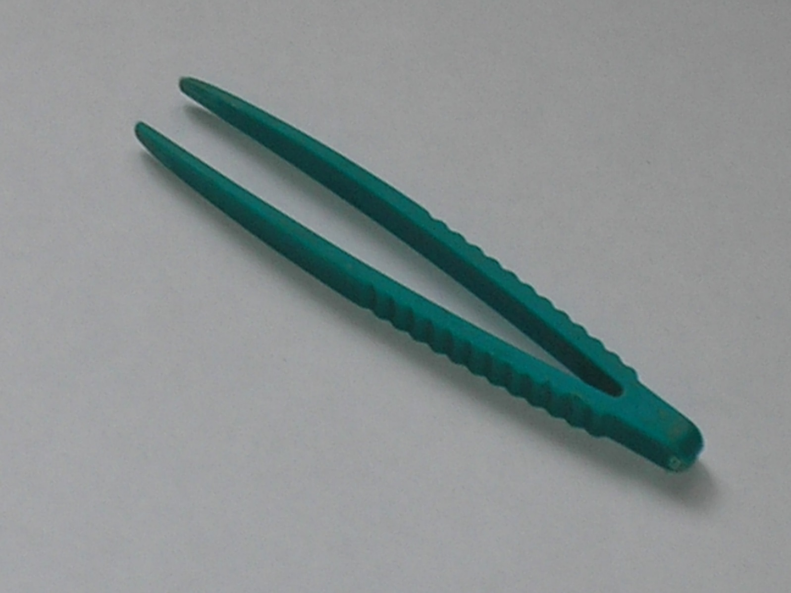
What is this science tool? What is this tool used for?

Slide 10
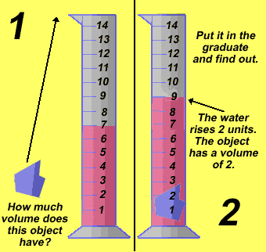
What is this science tool? What is this tool used for?

Slide 11
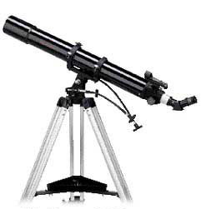
What is this science tool? What is this tool used for?

Slide 12
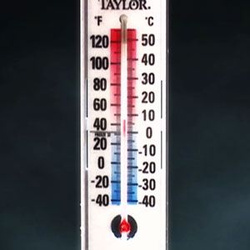
What is this science tool? What is this tool used for?

Slide 13
What is this science tool? What is this tool used for?

Slide 14
What is this science tool? What is this tool used for?

Slide 15
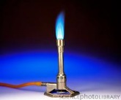
What is this science tool? What is this tool used for?

Slide 16
What is this science tool? What is this tool used for?

Slide 17
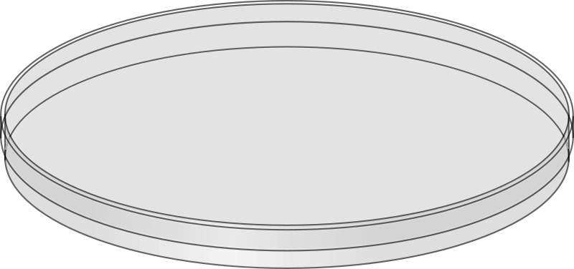
What is this science tool? What is this tool used for?

Slide 18
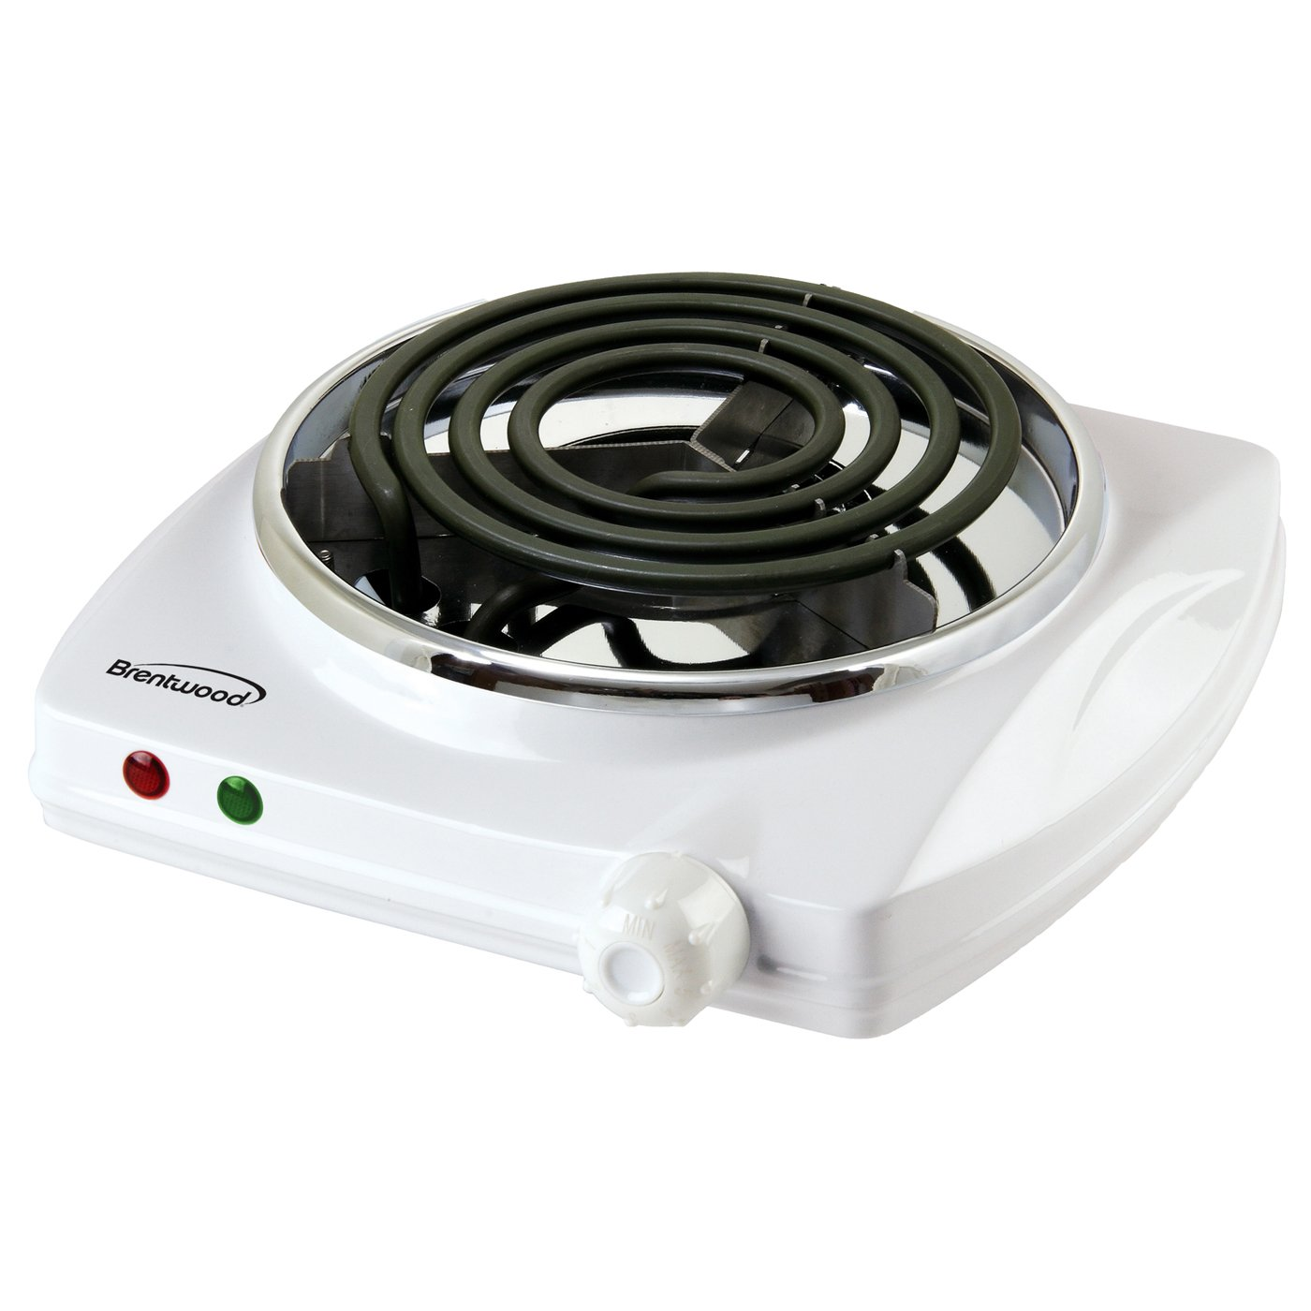
What is this science tool? What is this tool used for?

Slide 19
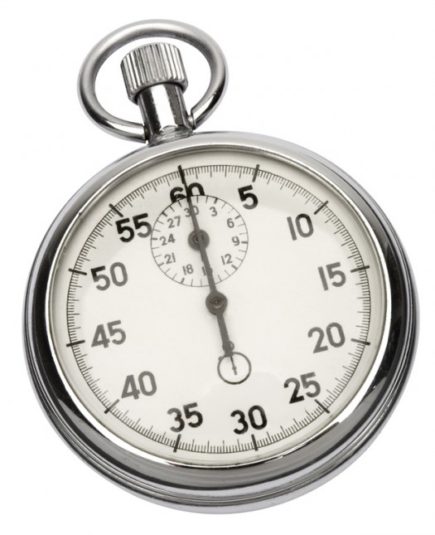
What is this science tool? What is this tool used for?

Slide 20
What is this science tool? What is this tool used for?

Slide 21
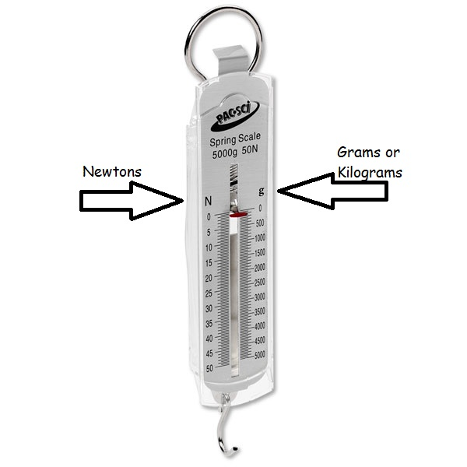
What is this science tool? What is this tool used for?

Slide 22
What is the variable that is changed?
Independent Variable

Slide 23
What is the variable (s) that are not changed called?
Constants or
Controls

Slide 24
What is the results of an experiment called?
Dependent Variables

