Slide 1
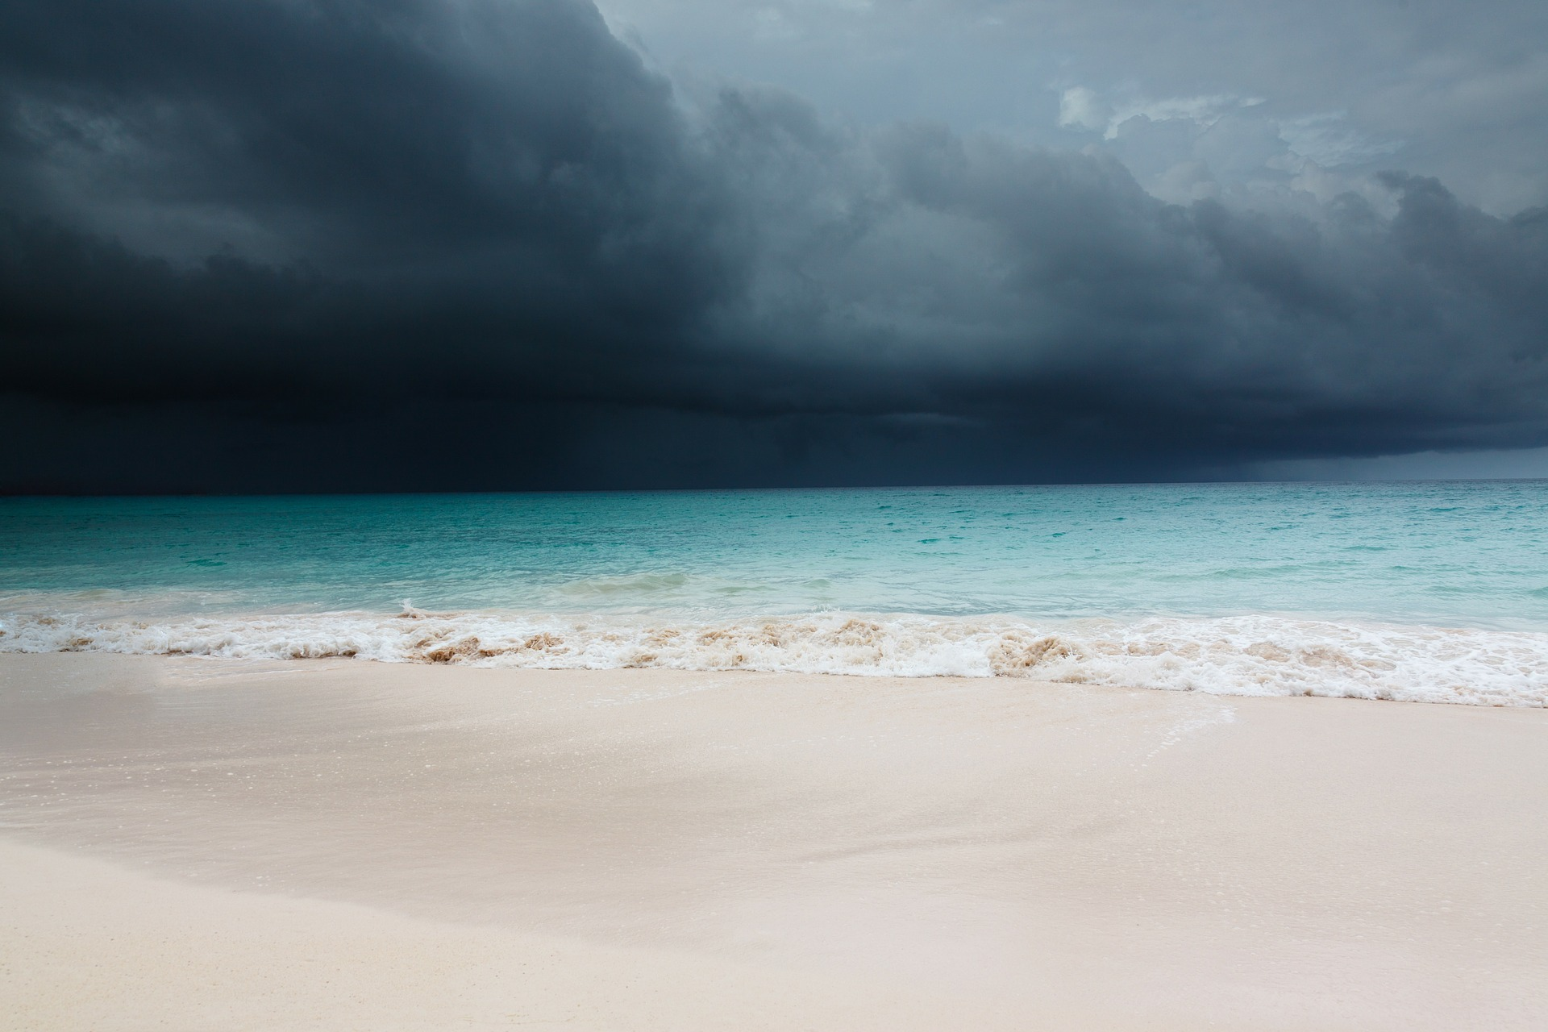
Hurricanes
© The Science Duo

Slide 2
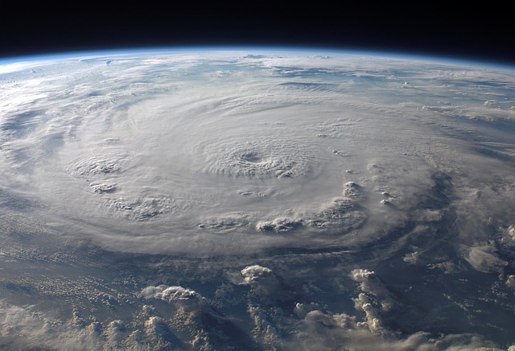
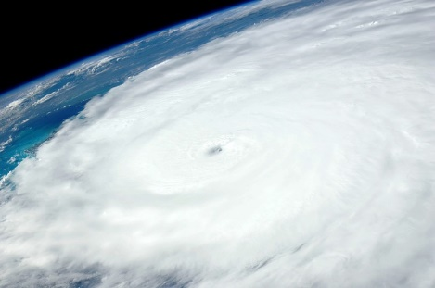
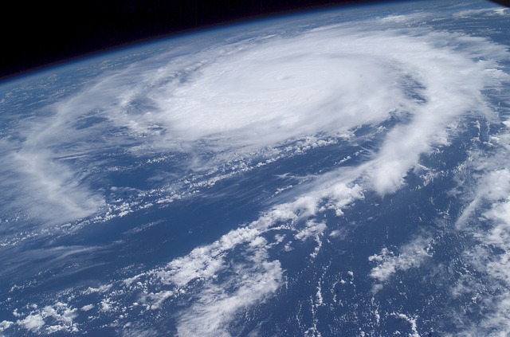
Hurricanes
Huge storms that form in the ocean and spin counterclockwise
Bring powerful wind and heavy rain
Wind speeds greater than or equal to 74 miles per hour
Also referred to as cyclones or typhoons in other locations of the world
Examples of Hurricanes
Hurricane Felix
Hurricane Irene
Hurricane Frances

Slide 3
Hurricane Categories
Hurricanes are categorized by their wind speed
Saffir-Simpson Scale – a scale used to measure the intensity of a hurricane
There are 5 categories of hurricanes
Category 1 – winds 74 – 95 mph; Bertha 1996
Category 2 – winds 96 – 100 mph; Arthur 2014
Category 3 – winds 111 – 130 mph; Sandy 2012
Category 4 – winds 131 – 155 mph; Ophelia 2005
Category 5 – winds 156 or greater; Katrina 2005
Tropical Depression – a spinning storm with winds less than 39 mph
Tropical Storm – a spinning storm with winds between 39 – 73 mph

Slide 4
Hurricane Formation
Must have warm ocean water – 80° Fahrenheit (about 27° Celsius) or warmer
Requires warm, moist air – low pressure system
Light winds begin to intensify if the storm is fueled by warm water; counter-clockwise wind rotation
Hurricane season in the Atlantic Ocean – June through November
Hurricanes weaken over land because they need the warm, moist water of the ocean as fuel

Slide 5
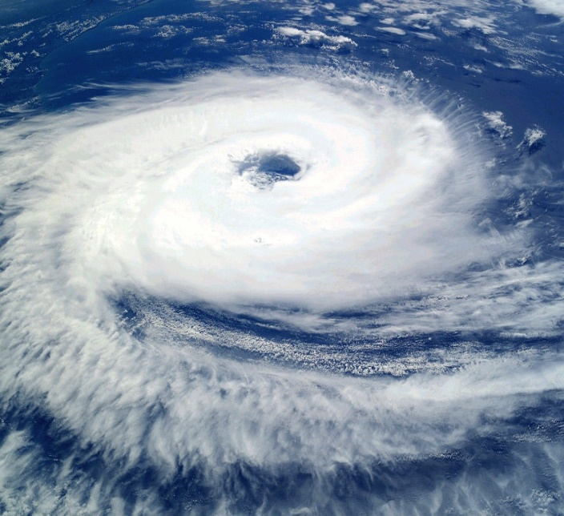
Parts of a Hurricane
Eye – the calm, center part of a hurricane
Eye Wall – the area surrounding the eye of a hurricane
Spiral Bands – outer rain bands of dense thunderstorms that can extend several hundred miles from the center
Eye
Eye Wall
Spiral Bands

Slide 6
Hurricane vs. Tropical Depression Venn Diagram
Tropical Depressions
Hurricanes
Both
Wind speeds 74 miles per hour or greater
More organized and powerful storm
Storm is given a name (ex. Katrina, Andrew, etc.)
Wind speeds below 39 miles per hour
Less organized than a hurricane
Not given a name until it is upgraded to a tropical storm
Cause damage
Storms
Form in warm water and low pressure

Slide 7
Checkpoint
5 checkpoint questions
Discuss each question with a partner
Write a complete answer to each question on your notes page

Slide 8
Question 1
What is the minimum wind speed for a hurricane?

Slide 9
Question 2
Identify 3 conditions that must be present for a hurricane to form.

Slide 10
Question 3
What are other terms used for hurricanes?

Slide 11
Question 4
What scale measures the intensity of a hurricane? How many categories are there?

Slide 12
Question 5
Identify 3 different parts of a hurricane.

