Slide 1
Simple Circuits & the Transfer of Electrical Energy

Slide 2
Parts of an Electrical Circuit
Electrical energy is the energy of charged particles in matter.
Electrical circuit is a path for the flow of electrical energy.
Electrical circuits are set up so they can transform electrical energy into other forms of energy.

Slide 3
Parts of an Electrical Circuit
Electrical circuits have three main parts.
A source of electrical energy, output device or a load, and connectors between the two.

Slide 4
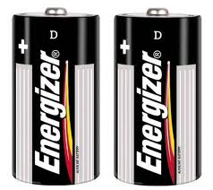
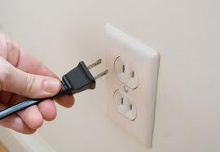
Electrical Source
Electrical source can be anything that supplies electricity .

Slide 5
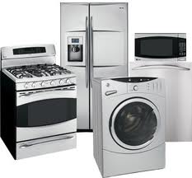
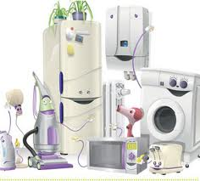
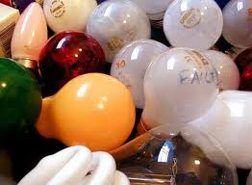
Output Device
An output device or load is anything that can use the electricity.

Slide 6
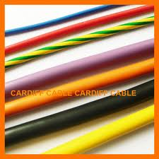
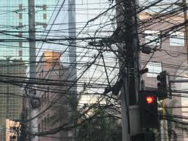
Connectors
Connectors are usually wires.

Slide 7
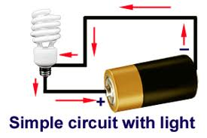
Simple Circuit
Electric current is the flow of electrical energy through a circuit.
Is this circuit complete?
Why?

Slide 8
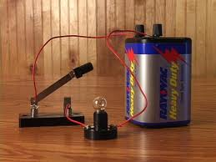
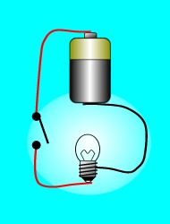
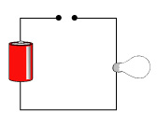
Open Circuit
An open circuit has a break in the flow of electricity.
A switch is the device that opens or closes a circuit.
The switch is made of metal, like the wire, so an electric current can pass through it.

Slide 9
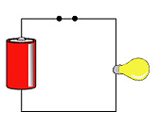
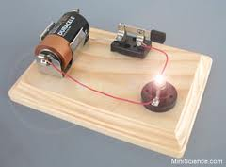
Closed Circuit
A closed circuit is a complete path for the flow of electricity.
The switch is closed , so the flow of electricity is not interrupted.

Slide 10
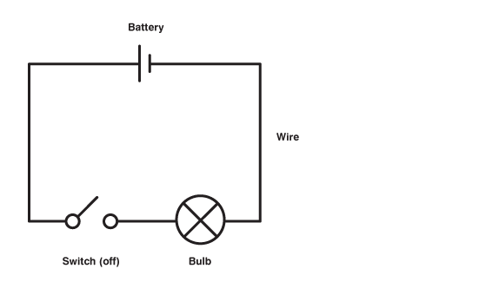

Slide 11
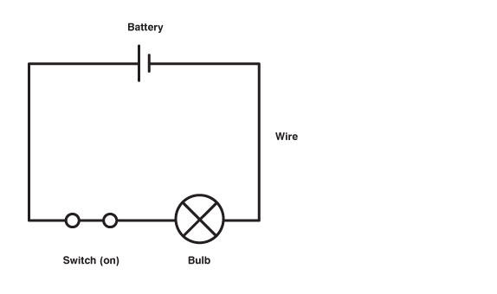

Slide 12
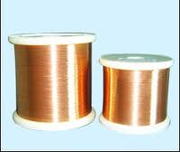
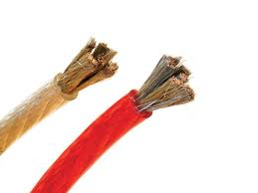
Conductors
Electrical energy moves through some materials better than it does others.
A conductor is a material that allows electric current to pass through it easily.
Metals conduct electricity well.
Examples are aluminum and copper.

Slide 13
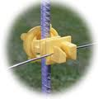
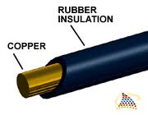
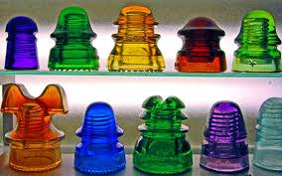
Insulators
An insulator is a material that does not let electric current pass through it easily.
Most wires are wrapped in plastic or rubber.
Other insulators are glass, wood, and air.

Slide 14
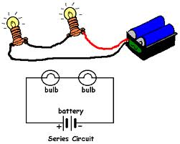
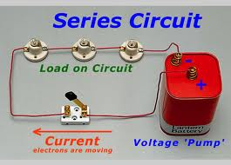
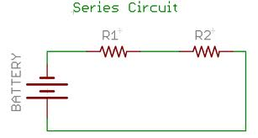
Series Circuit
A series circuit is a circuit in which all parts are connected in a single loop. There is only one path for charges to follow, so the charges must flow through each part of the circuit.

Slide 15
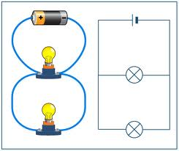
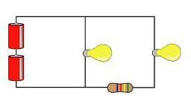
Parallel Circuits
A parallel circuit is a circuit in which loads (output devices) are connected side by side. Charges have more than one path on which they can travel.

Slide 16
