Slide 1
Egyptian Civilization
Geography and Ancient Egypt
Section ONE

Slide 2
Geography and Ancient Egypt
The Big Idea
The water, fertile soils, and protected setting of the Nile Valley allowed a great civilization to arise in Egypt around 3200 BC.
Main Ideas
Egypt was called the gift of the Nile because the Nile River gave life to the desert.
Civilization developed along the Nile after people began farming in this region.
Strong kings unified all of Egypt.

Slide 3
Main Idea 1: Egypt was called the gift of the Nile because the Nile River gave life to the desert.
The Nile River brought life to Egypt and allowed it to thrive.
Biannual flooding of the Nile made farming possible.

Slide 4
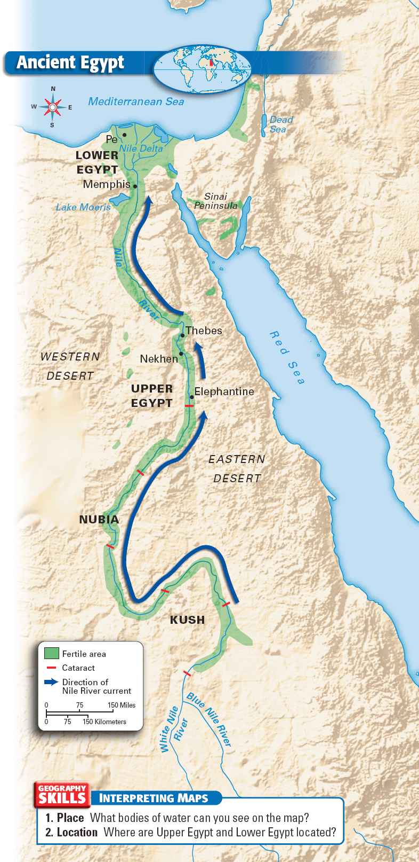

Slide 5
Features of the Nile
The Nile is the longest river in the world, with a distance of over 4,000 miles.
Ancient Egypt included two regions, a southern and a northern region, that were given their names by their relation to the Nile.
At several points, the rough terrain caused cataracts, or rapids, to form.
The Nile divided into several branches, forming a delta, a triangular area of land made from soil deposited by a river.

Slide 6
The Floods of the Nile
Little rain fell in the Egyptian desert, but the Nile flooded every year in the summer and fall.
The Nile’s flooding coated the land around it with a rich silt that made the soil ideal for farming.
Without the floods, people could never have farmed in Egypt.

Slide 7
Main Idea 2: Civilization developed along the Nile after people began farming in this region.
The Nile provided both water and fertile soil for farming.
Egypt’s location offered another advantage because it had natural barriers that made it hard to invade.

Slide 8
Nile Valley
Canals were built to carry water to fields of wheat, barley, fruits, and vegetables.
The Nile allowed farmers to raise animals such as cattle and sheep.
The river also provided many types of fish to eat, and hunters trapped ducks and geese.
Natural barriers made Egypt hard to invade.
Desert in the west was too big and harsh to cross.
Mediterranean and Red Sea provided protection from invasion.
Cataracts in the Nile made it difficult to invade from the south.

Slide 9
Main Idea 3: Strong Kings unified all of Egypt.
According to tradition, Menes rose to power in Upper Egypt and unified the two kingdoms by taking control of Lower Egypt and by marrying a Lower Egyptian princess.
Menes was probably Egypt’s first pharaoh, the title used by the rulers of Egypt.
He also founded Egypt’s first dynasty, or series of rulers from the same family.
The First Dynasty lasted for about 200 years and extended Egyptian territory southward along the Nile.

Slide 10
The Old Kingdom
Section Two

Slide 11
The Old Kingdom
The Big Idea
Egyptian government and religion were closely connected during the Old Kingdom.
Main Ideas
In early Egyptian society, pharaohs ruled as gods and were at the top of the social structure.
Religion shaped Egyptian life.
The pyramids of Egypt were built as tombs for the pharaohs.

Slide 12
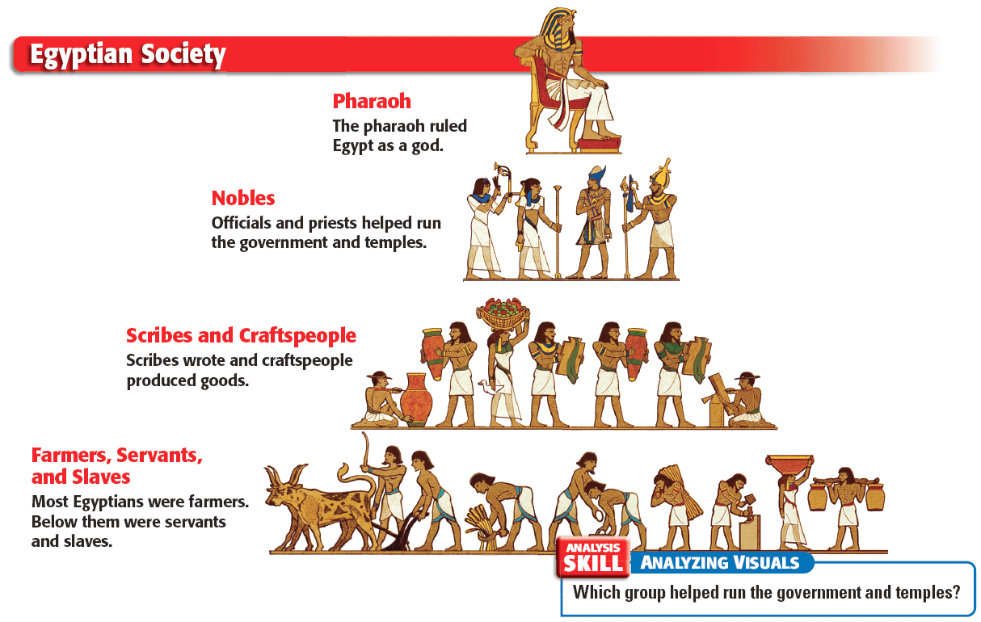

Slide 13
Main Idea 1: In early Egyptian society, pharaohs ruled as gods and were at the top of the social structure.
The Old Kingdom was a period in which the Egyptians developed a system based on the belief that the pharaoh was both a king and a god.
As the population grew, social classes appeared.
Egypt began to trade goods with its neighbors.

Slide 14
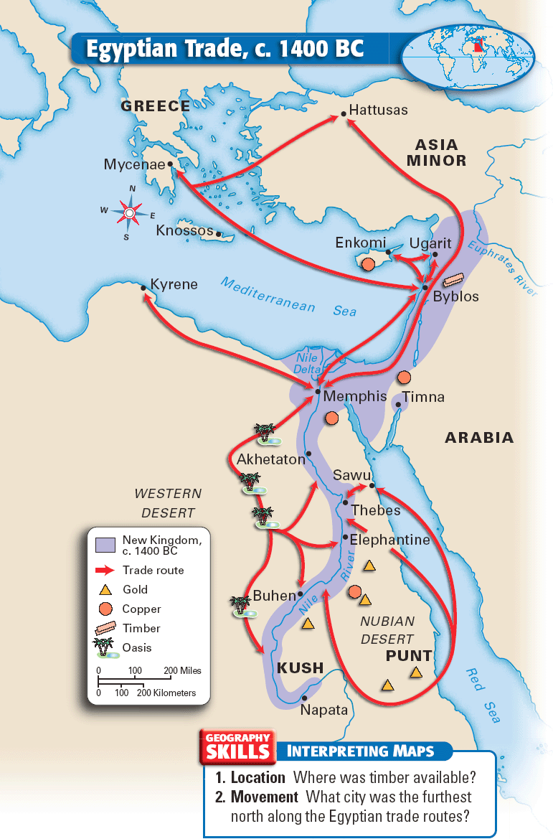

Slide 15
Egyptian Society
Social classes
Pharaohs ruled Egypt as gods.
Many nobles, or people from rich and powerful families, were officials and priests who helped run the government.
Scribes and craftspeople wrote and produced goods.
Farmers, servants, and slaves made up most of Egyptian society.

Slide 16
Main Idea 2: Religion shaped Egyptian life.
The Egyptians had gods for nearly everything, including the sun, the sky, and the earth. These gods would often mix human and animal forms.
Egyptian religion focused on the afterlife, or life after death.
They believed that when a person died, his or her ka left the body and became a spirit.
They developed embalming to preserve bodies and keep the link between the body and the spirit. The specially treated bodies wrapped in cloth were called mummies.

Slide 17
Main Idea 3: The pyramids of Egypt were built as tombs for the pharaohs.
Pyramids are huge stone tombs with four triangular sides that meet in a point on the top. Historians are unsure how they were built.
Pyramids displayed amazing engineering, or the application of scientific knowledge for practical purposes.
The size and shape of the pyramids showed the importance of pharaohs. They were the people’s link to the gods, so the Egyptians wanted their spirits to be happy.

Slide 18
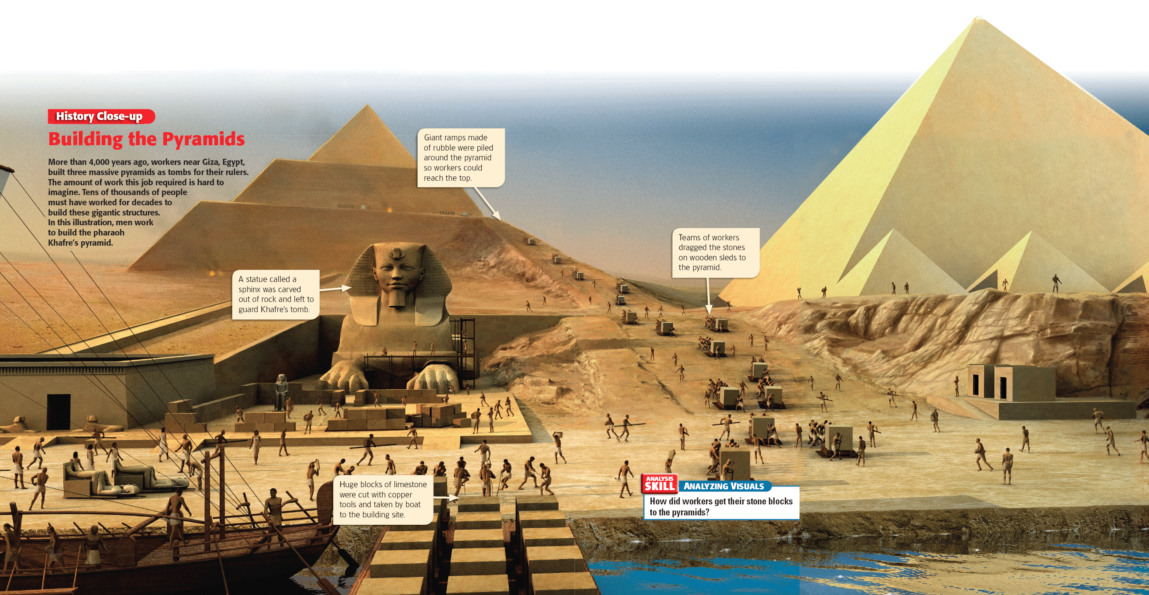

Slide 19
The Middle & New Kingdoms
Section Three:

Slide 20
The Middle and New Kingdoms
The Big Idea
During the Middle and New Kingdoms, order and greatness were restored in Egypt.
Main Ideas
The Middle Kingdom was a period of stable government between periods of disorder.
In the New Kingdom, Egyptian trade and military power reached their peak, but Egypt’s greatness did not last.
Work and daily life were different for each of Egypt’s social classes.

Slide 21
Main Idea 1: The Middle Kingdom was a period of stable government between periods of disorder.
Following a period of competition for power between the nobles and the pharaohs, the Middle Kingdom began.
Egypt fell into disorder around 1750 BC. A group called the Hyksos invaded and ruled the region for
200 years.
The Egyptians fought back, and Ahmose of Thebes declared himself king and drove the Hyksos out of Egypt, beginning the New Kingdom.

Slide 22
Main Idea 2: In the New Kingdom, Egyptian trade and military power reached their peak, but Egypt’s greatness did not last.
Fearing future invasions, the Egyptians took control of all possible invasion routes into the kingdom.
Egypt took over vast lands and was the leading military power in the area.
Egypt became rich because of the lands it conquered.

Slide 23
Growth and Effects of Trade
Conquests brought traders into contact with distant lands, and trade routes, or paths followed by traders, developed.
Queen Hatshepsut encouraged trade and used the profits to support the arts and architecture.
Led by Ramses the Great, Egypt fought invaders for many years, leaving their empire diminished.

Slide 24
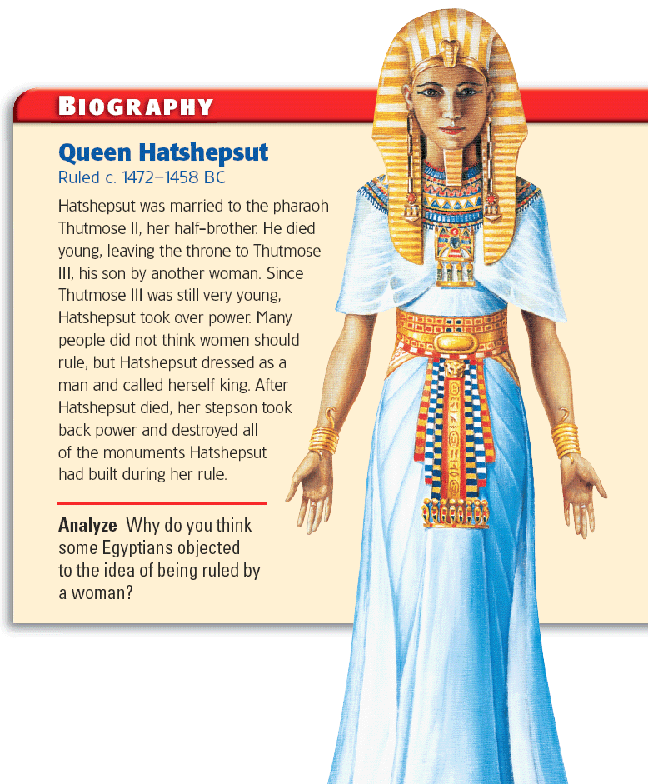

Slide 25
Main Idea 3: Work and daily life were different for each of Egypt’s social classes.
The complex society required people to take on many different kinds of jobs.
Family life was very important in Egyptian society, and most Egyptians lived in their own homes.
Women had many legal rights, including owning property, making contracts, and divorcing their husbands.

Slide 26
Egyptian Jobs
Scribes
Few people were more respected than scribes. They did not have to pay taxes, and many became wealthy.
Artisans, Artists, and Architects
These jobs required advanced skills and were also very admired in Egypt.
Merchants and Traders
Although trade was important, few held these positions. Some had to travel very long distances to buy and sell goods.

Slide 27
Additional Egyptian Jobs
Soldiers
Egypt created a permanent army that offered soldiers a chance to rise in social status and receive land as payment.
Farmers and Other Peasants
This group made up the vast majority of the population. They grew crops to support their families and to pay taxes.
Slaves
Slaves were usually criminals or prisoners. They had some legal rights, however.

Slide 28
Egyptian Achievements
Section Four

Slide 29
Egyptian Achievements
The Big Idea
The Egyptians made lasting achievements in writing, architecture, and art.
Main Ideas
The Egyptians developed a writing system using hieroglyphics.
The Egyptians created magnificent temples, tombs, and works of art.

Slide 30
Main Idea 1: The Egyptians developed a writing system using hieroglyphics.
Hieroglyphics was the Egyptian writing system.
Egyptians learned to write hieroglyphics on papyrus, a long-lasting, paper like material made from reeds.
Scribes wrote on papyrus using brushes and ink.
Historians learned how to read hieroglyphics after discovering the Rosetta Stone, which was written in three languages.
Hieroglyphics
A later form of Egyptian
Greek

Slide 32
Main Idea 2: The Egyptians created magnificent temples, tombs, and works of art.
Egyptians believed the massive temples were homes of the gods.
People visited to worship, offer gifts to the gods, and ask for favors.
Temples had
Stone sphinxes and other statues
An obelisk: a tall, four-sided pillar that is pointed at the top
Painted walls and columns that also had hieroglyphics

Slide 34
Egyptian art filled tombs.
Egyptian art was filled with lively, colorful scenes.
Art showed historical events, everyday life, and religious events.
Painting had a distinctive style in which people’s heads and legs are always seen from the side, but upper bodies are shown straight on.
Tombs contained work such as:
Art and hieroglyphics on walls and columns
Stone statues and carvings
Egyptians were skilled stoneworkers.
Jewelry

Slide 35
Ancient Kush
Section Five

Slide 36
Ancient Kush
The Big Idea
The kingdom of Kush, which arose south of Egypt in a land called Nubia, developed an advanced civilization with a large trading network.
Main Ideas
The geography of early Nubia helped civilization develop there.
Kush and Egypt traded, but they also fought.
Later Kush became a trading power with a unique culture.
Both internal and external factors led to the decline of Kush.

Slide 37
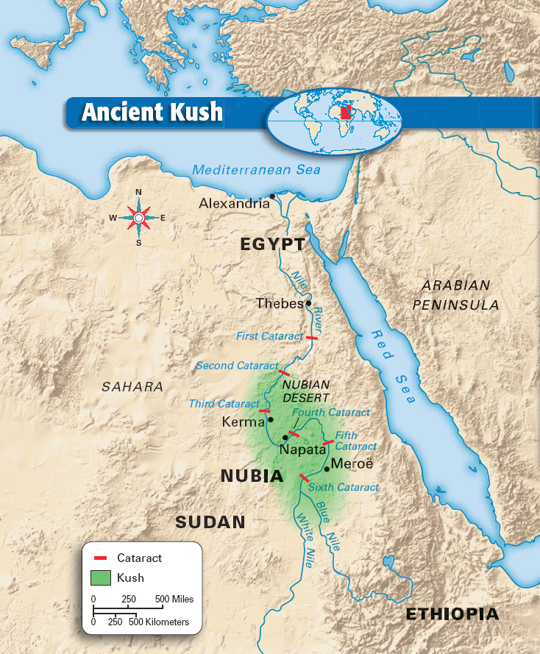

Slide 38
Main Idea 1: The geography of early Nubia helped civilization develop there.
A group of people called the Kushites settled in a region now called Nubia and established the first large kingdom in the interior of Africa.
The development of the Kushite civilization was greatly influenced by the geography of Nubia, especially the role played by the Nile River.

Slide 39
Nubia
Ancient Nubia was fertile due to annual flooding.
It was rich in valuable minerals that contributed to its wealth.
Gold
Copper
Stone
Farmers thrived there, and one became the king of a region he called Kush.
The capital city of Kerma was protected from invaders by the cataracts of the Nile River.

Slide 40
Main Idea 2: Kush and Egypt traded, but they also fought.
Egypt and Kush traded with each other. However, relations between Kush and Egypt became hostile. Egypt feared that Kush would become too powerful, so it invaded and conquered Kush.
Kush was an Egyptian territory for about 450 years. Many Kushites adopted Egyptian religious practices, names, and language.
During a time of decline in Egypt, Kushite leaders regained control of Kush, becoming independent again.

Slide 42
Kush Regains Power
Kush regained its strength and conquered Egypt under the direction of Kashta and his son Piankhi.
By 751 BC the Kushite king Kashta had conquered Upper Egypt. Piankhi ruled all of Egypt by the time of his death around 716 BC.
Shabaka, brother of Piankhi, declared himself pharaoh and began the Kushite Dynasty.
This dynasty tried to restore the old Egyptian cultural practices.
The Kushite Dynasty remained strong until the Assyrians drove them out of Egypt in the 670s BC.

Slide 43
Main Idea 3: Later Kush became a trading power with a unique culture.
Kush devoted itself to increasing agriculture and trade. Within a few centuries, it became a rich and powerful kingdom again.
Meroë, the kingdom’s new capital, developed an iron industry.
Resources such as iron ore and wood for furnaces helped the industry grow quickly.
Meroë became the center of a large trade network, a system of people in different lands who trade goods.

Slide 44
Kushite Culture
Kushite culture was influenced by Egypt. They worshipped Egyptian gods, built pyramids, wore Egyptian clothing, and had rulers called pharaohs.
The Kushites also had their own gods.
They developed their own written language, called Meroitic.
The women of Kush were expected to be as active in society as the men. Some rose to positions of authority and power, especially religious authority.

Slide 45
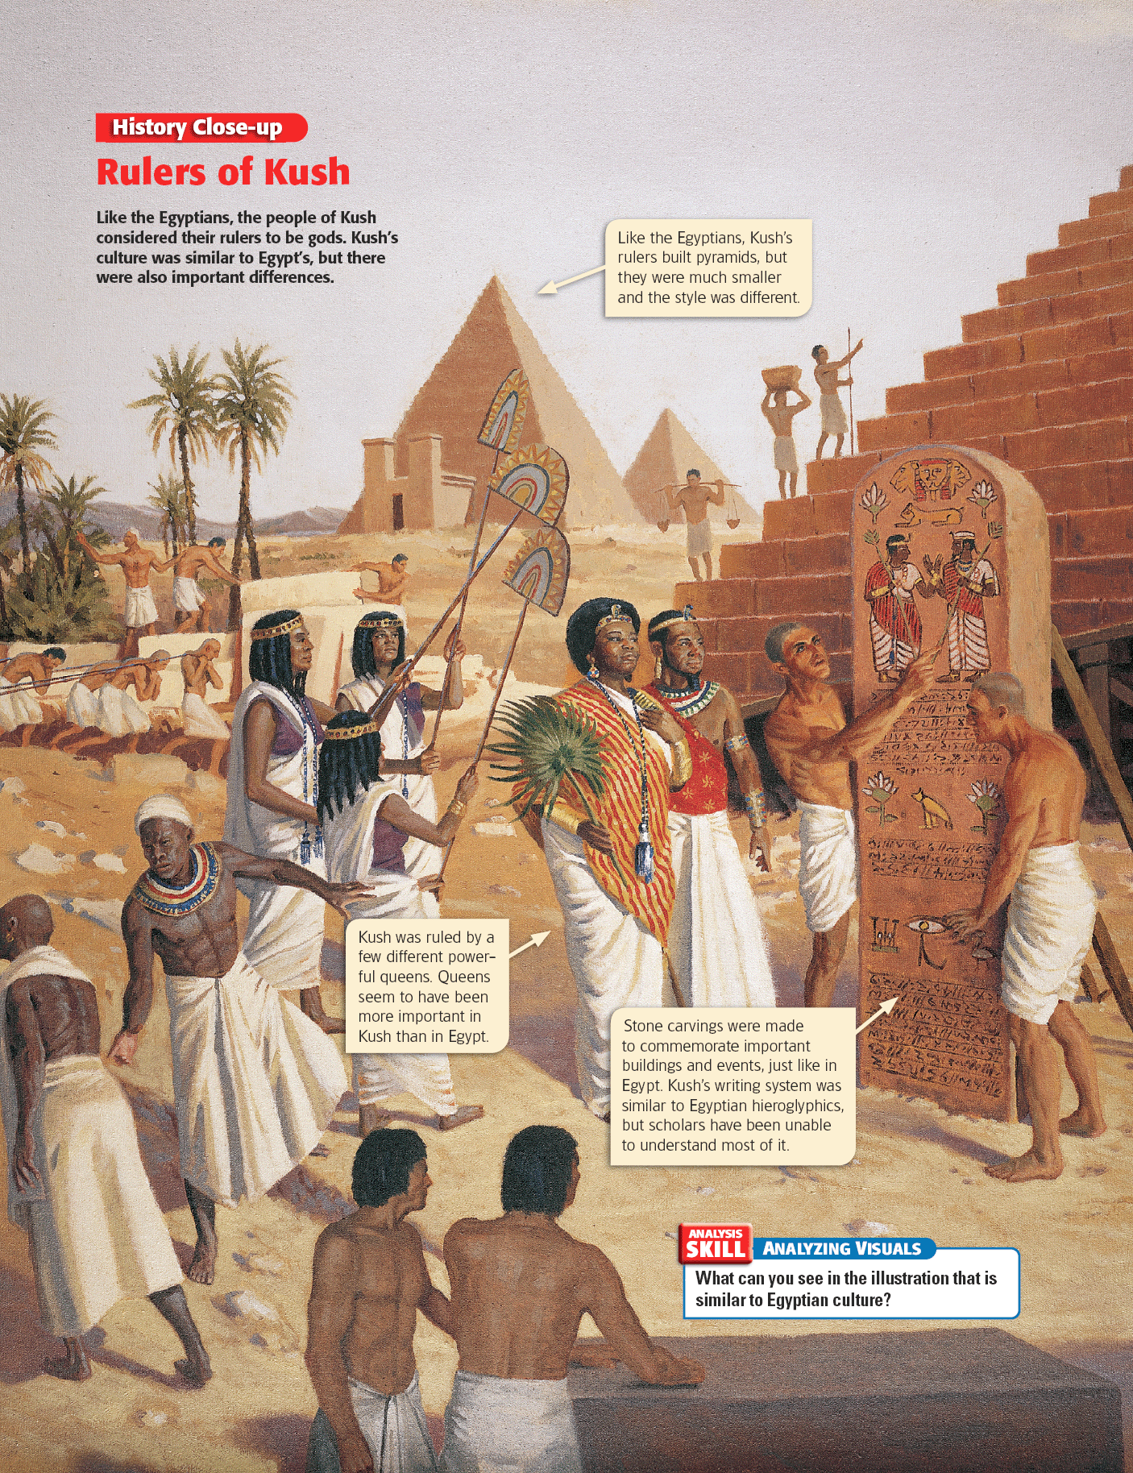

Slide 46
Main Idea 4: Both internal and external factors led to the decline of Kush.
Loss of Resources
Cattle overgrazed the land, leaving nothing to hold the soil down and allowing it to blow away.
Ironmakers used up the forests near Meroë. Military power declined when weapons were not produced.
Trade Rivals
Merchants set up new trade routes that went around Kush, weakening its trade.
Rise of Aksum
The Aksumite army of King Ezana took over when Kush’s power started to decline.

Slide 47
