Slide 1
Ecological Succession
The replacement of one type of community by another at a single place over a period of time.

Slide 2
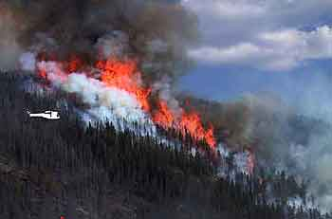
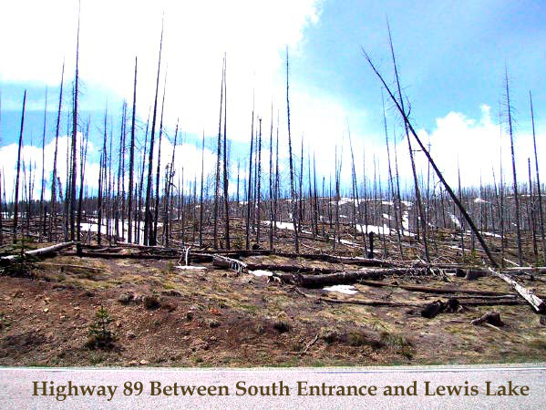

Slide 3
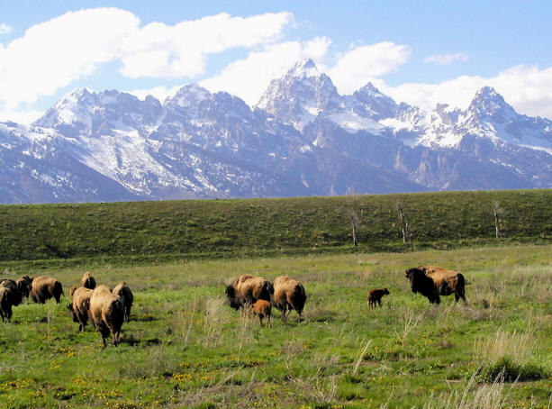
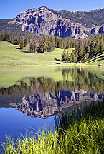
One year later
Today

Slide 4
Primary Succession
Area with NO soil
Land without plants or animals
Usually formed by a volcano
Pioneer Species are the first plant life usually in the form of Lichens.
Soil is formed by the decomposer of lichens and erosion of the rock.
After hundreds of years, the soil may be deep and stable enough to support a forest.

Slide 5
Secondary Succession
Land that has been there, but the living organisms have been destroyed.
Soil is present and seeds are in the soil
Secondary succession usually occurs when land is destroyed by fire or humans removing a building or clearing.

Slide 6
Mature Community
Full grown community of plants and animals
Whatever organisms are there will stay there until they die or something destroys them.
Disturbances are caused by:
Fire, Humans, Avalanches, or Volcanoes.

