Slide 1
The First Humans
Hominids are the family of mankind and his or her relatives.
Written by Lin Donn
Illustrated by Phillip Martin

Slide 2
65 Million Years Ago
No matter what you may have seen in the movies, early man did not live during the same period in history as dinosaurs!
Dinosaurs died out about 65 million years ago. The first human like hominids did not appear until around 3 million years ago.
Not that early man had it easy, but he did not have to fight dinosaurs!

Slide 3
3 Million Years Ago
3 million years ago, our planet was teeming with life!
There were deer, giraffes, hyenas, sheep, goats, horses, elephants, camels, beavers, cave lions, ants, termites, woolly mammoths, saber-toothed tigers, giant sharks, dogs with huge teeth, and all kinds of birds and plants and fish.

Slide 4
Very Early Humans
It was during this time that the higher primates, including apes and early man, first appeared.
There was a difference between apes and man. Early human-like hominids could stand upright. Apes could not.
Their hands were different, too. Ape hands were made for climbing and clinging. Man’s hands were jointed differently, which allowed them to make and use tools.

Slide 5
Very Early Humans
How do scientists know about an early man who lived 3 million years ago?
Lucy told them!

Slide 6
Lucy
In 1974, a skeleton was found in Africa. The bones were those of a female, about 20 years old or so when she died. Scientists named her Lucy. About 3 million years
ago, when Lucy was alive, she was about 4 feet tall and weighed about 50 pounds. Scientists suspect that she fell into a lake or river and drowned.
Scientists are like detectives. They can tell a great deal from a skeleton, whether it's one year old or 3 million years old!

Slide 7
Fossils & Artifacts
Scientists use many clues to help them put pieces of the past together. One thing they must know is the difference between a fossil and an artifact.
Fossils are remains of living things (plants, animals, people), not things that were made.
Artifacts are remains of things that were made, not remains of living things.

Slide 8
Handy Man- Homo habilis - Paleolithic Era
The Stone Age refers to the materials used to make man-made tools. In the Stone Age, man made tools out of stone. “Handy Man” was one of the first hominids to use stone tools.
Hunters & Gatherers: The Old Stone Age people were hunters/gatherers. We know this because scientists have found fossils and artifacts, which reveal traces of their life. These people did not plant crops. They gathered wild fruits, nuts, berries, and vegetables.

Slide 9
Handy Man – Homo habilis
These early human-like hominids were taller and smarter than Lucy’s people, but they did not know how to make fire.
When they broke camp, they probably tried to bring fire with them by carrying lit branches to use to start a new campfire.
If their branches went out, they did without fire until they found something burning.

Slide 10
Upright Man – Homo erectus * Mesolithic Era
Many years passed. Another group of man was born. Scientists nicknamed this group “Upright Man”. Upright Man did know how to make fire.
That changed everything!
People began to cook their food, which helped to reduce disease. People collected around the fire each night, to share stories of the day's hunt and activities, which helped to develop a spirit of community.

Slide 11
Upright Man- Homo erectus
These Stone Age people were about the same size as modern humans. Their tool-making skills were considerably improved. Their weapons included stone axes and knives.
Because Upright Man could make fire, he was free to move about in search of food (Nomads). He did not have to worry about freezing. He made warm clothes from animal skins. At night, he built a campfire to cook his food and to stay warm.

Slide 12
Man Leaves Home
About one million years ago, Upright Man began to slowly leave Africa. These early people began to populate the world.
They did not need a boat. The Ice Age was here! They traveled across giant walkways of frozen ice, over what later would become vast rivers and seas.
Scientists have found artifacts of their tools and weapons, which help us to understand how they lived, where they went, and how they got there.

Slide 13
EARLY HUMAN MIGRATION

Slide 14
Neanderthals
One day, scientists found a new skeleton. This skeleton was from another group of early men. Scientists named this man Neanderthal man, after the valley, Germany in which the skeleton had been found.
First to bury their dead
Clothes from animal skins
Lived in caves and tents

Slide 15
Neanderthals
Still, Neanderthals were different from other species of early humans. They were tall and smart, and used caves as their homes. They were great hunters.
Considering how smart they were, and how advanced for their time, scientists are puzzled that the Neanderthals were one of the early species of man to die out. Many species of man died out in these early days. But why the Neanderthals? It is a history mystery.

Slide 16
Cro-Magnon Man – Homo sapiens Wise man
Another group of early men stood out during this period. Scientists nicknamed this group “Cro-Magnon man”.
Cro-Magnon man lived in Europe.
This group did not live a life of constant struggle for survival because they worked together to provide food for their tribe.

Slide 17
Cro-Magnon Man
These Stone Age people
Learned to cure and store food for the long winter. Used traps
Fisherman used nets and fishhooks.
Built rafts and canoes
Made & used pottery
Used dogs for protection & hunting
They made clothing and jewelry.
They invented the bow and arrow.

Slide 18
Cave Paintings
Cro-Magnon man did something rather unusual. For some reason, he drew paintings deep inside dark caves, on cave walls.
Colors used most often were brown, yellow/tan, dark red, and coal black.
Animals were well drawn and filled in with natural colors to give them even more shape and substance.
They drew stick figures for hunters.
They drew stencils of hands.

Slide 19
Cave Paintings
To reach the deepest part of the cave, where other paintings could be found, Cro-Magnon man had to crawl through the maze like tunnels of the cave, holding a spoon-like oil lamp to light his way, while carrying his carefully prepared paints. He had to watch for animals!
Notes:
Teacher Notes: To avoid being burned, and to avoid having the lamp go out, it had to balanced carefully to hold the burning oil inside the rounded part of the spoon-like oil lamp.

Slide 20
Lascaux France
The existence of cave paintings was discovered by accident. Around 1940, during World War II, some kids
were playing in a field in Lascaux, France. They stumbled across a cave entrance. It had been hidden by the tree roots. The walls were covered with cave paintings!
Once people knew the paintings existed, they looked for more such caves, and found them.
Notes:
Teacher Notes: Caves with paintings in them have been found in many parts of the world. There are probably more caves to be discovered.

Slide 21
Neolithic Age – New Stone Age 10,000-4,000 BCE/BC
Gradual shift from
Nomadic lifestyle (moving to follow food supply or weather
TO:
Settled, Stationery

Slide 22
Gradual Shift from:
Hunting/Gathering
TO:
Agriculture/farming AND
Domestication of animals

Slide 23
Neolithic/ Agricultural Revolution
Why was the “Neolithic Revolution” a turning point in human history?

Slide 24
The Agricultural Revolution
8,000 BCE – 5,000 BCE
Agriculture developed independently in different parts of the world.
SLASH-AND-BURN Farming
Middle East India Central America China Southeast Asia
8,000 BCE 7,000 BCE 6,500 BCE 6,000 BCE 5,000 BCE

Slide 25
Early Settled Communities
Growing crops on a regular basis made possible the support of larger populations
More permanent, settled communities emerged.
8,000 BCE → Largest Early Settlement at Çatal Hüyük ( Modern Turkey ) → 6,000 inhabitants

Slide 26
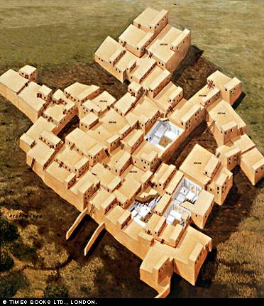
Catal Huyuk
12 Cultivated crops
Division of labor
Engaged in trade
Organized religion
Small Military

Slide 27
It Led to:
Cities!
And
Civilizations!!!

Slide 28
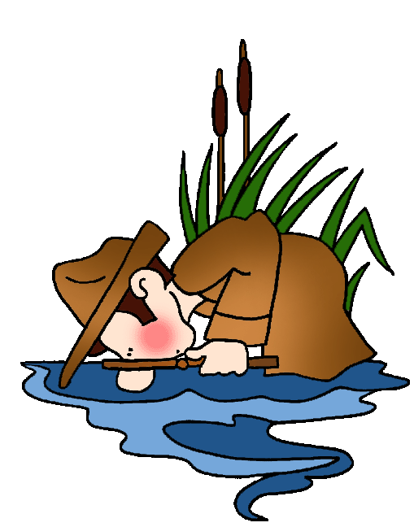
Civilization
Advanced cities
Specialized Workers
Complex Institutions –
Government
Religion
Record Keeping
Advanced Technology

Slide 29
Recap
We know about early Stone Age people because Archeologists/scientists have found fossils and artifacts that reveal traces of their life.

Slide 30
Early Humans
Questions
What is a hunter-gatherer?
What is a Stone Age?
Why was the ability to make fire so important?
How could early humans travel from Africa to Australia without a boat?
What did Cro-Magnon man paint on cave walls?
Why did Cro-Magnon man paint on cave walls?
Notes:
Answers:
Someone who gathers food growing wild, and hunts for food.
A time in history when tools were made from stone
Fire helped people survive. Fire was a source of heat, to stay warm in the Ice Age. Fire let them cook their food, which reduced the incident of disease. The ability to make fire allowed them to live and move about freely, in search of food and shelter, knowing they could relight a fire when needed.
It was the Ice Age. They walked.
Stick figures of people, well drawn animals, and stencil drawings of human hand prints
No one knows. It’s a history mystery. Archaeologists have put many pieces of the past together. But there are many pieces yet to be discovered.

Slide 31
…
This presentation is brought to you by Pete’s Power Point Station. Visit us on the web at pppst.com

