Slide 1
Biomes
Large geographic areas that have similar climates and ecosystems

Slide 2
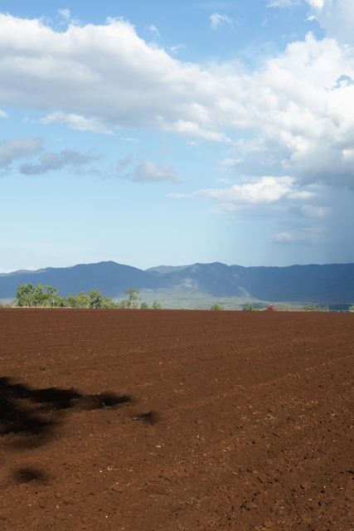
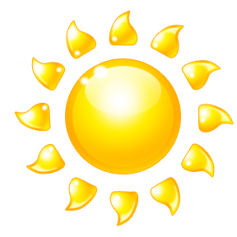
Biomes – a region with a distinct climate and set of organisms.
Biotic Factor – all living organism. Anything that has to have food and water to live.
Abiotic Factor – all nonliving parts of a biome (precipitation, temperature, sunlight, air, water, and soil)

Slide 3
Tundra
A cold, dry, treeless region sometimes called a cold desert.
Precipitation – 25cm (10in) per year
Temperature - -12⁰C (10⁰F)average daily temp.
Permafrost – frozen layer of soil just beneath the top layer of soil.

Slide 4
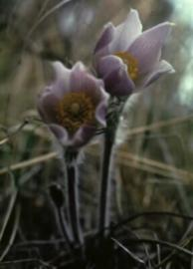
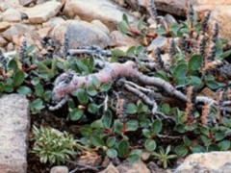
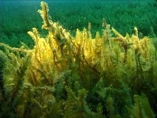
Tundra Life
Plants – mosses, grasses, and small shrubs.
Arctic Willow
Arctic Moss
Pasque Flower

Slide 5
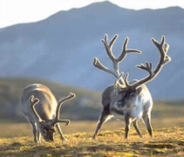
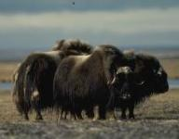
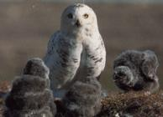
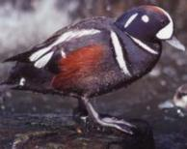
Tundra animals – insects, birds, mice, lemmings, caribou, reindeer, and musk oxen
Musk Oxen
Snowy Owl
caribou
Harlequin Duck

Slide 6
Taiga
Cold forest of mostly evergreen trees.
Short Summers
Precipitation – 35 -100 cm per year
Largest of the 7 Biomes

Slide 7
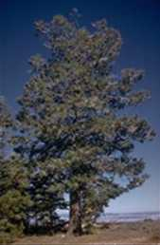
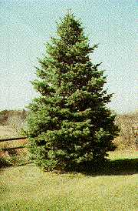
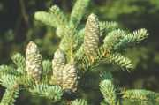
Taiga Plant Life
Balsam Fir
Douglas Fir
White Fir

Slide 8
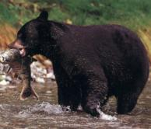
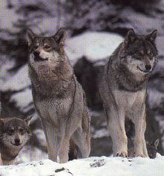
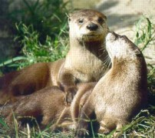
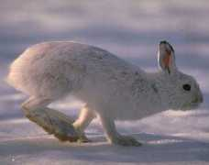
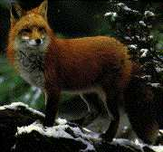
Taiga Animals
Black Bear
Grey Wolves
River Otter
Snowshoe Rabbit
Red Fox

Slide 9
Temperate Deciduous Forest
The biome that we live in
Has 4 distinct season: Winter, Spring, Summer, Fall
Trees loose their leaves each winter.
Precipitation – 75 – 150 cm per year.
Temp – below freezing – 30⁰C (86⁰F)
Large variety of plant and animal life.

Slide 10
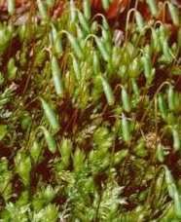
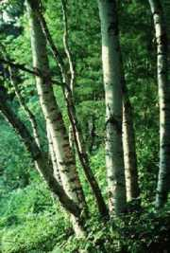
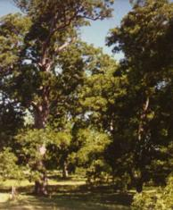
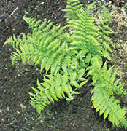
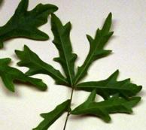
Temperate Deciduous Forest Plants
Carpet moss
Pecan Tree
White Birch
Ferns
Maple

Slide 11
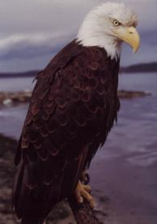
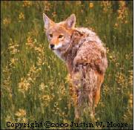
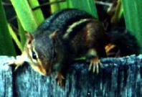
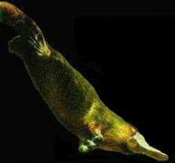
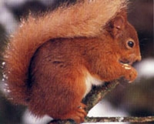
Temperate Deciduous Forest Animals
Chipmunk
Bald Eagle
Coyote
Red Tail Squirrel
Duckbill Platypus

Slide 12
Temperate Rain Forest
Forest of tall trees with needlelike leaves.
Temp – 9⁰ - 12⁰ C. (48⁰-54⁰F)
Precipitation – 200 – 400cm
Locations are New Zealand, southern Chile, and Pacific Northwest US
Many of the same types of plants and animals as in the Deciduous Forest.
Smallest of the 7 Biomes.

Slide 13
Tropical Rain Forest
The most biologically diverse of all biomes
Temp – 25⁰ C (77⁰F)
Precipitation – 200 cm – 600 cm in the form of rain.
Poor soil.
Made up of 4 zones: floor, understory, canopy and emergents.

Slide 14
The Zones/Strata
Floor – this is the floor of the forest and home to many insects and the largest mammals.
Understory – Dark, cool environment under the canopy and above the forest floor.
Canopy – Upper parts of the trees and is FULL of life – insects, birds, reptiles, and mammals
Emergents – The trees that are much taller than the average trees in the canopy. Home to birds and insects.

Slide 15
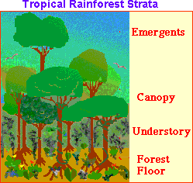

Slide 16
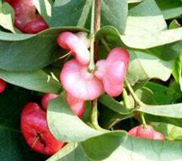
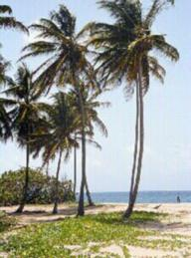
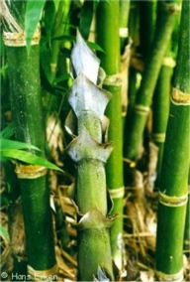
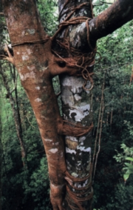
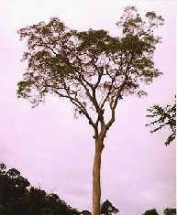
Plant Life
Watery Rose
Coconut Tree
Bengal Bamboo
Banyan Tree
Honey Bee Tree

Slide 17
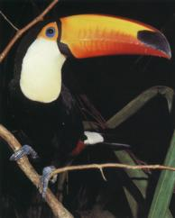
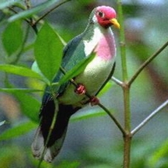
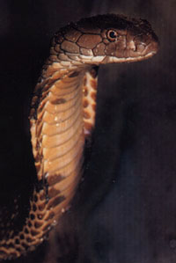
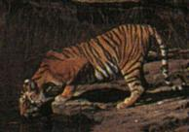
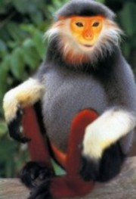
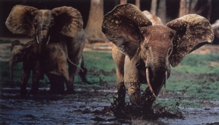
Animal Life
Jambu Fruit Dove
King Cobra
Toco Tucan
African Forest Elephant
Bengal Tiger
Red Shanked Docu

Slide 18
Desert
The driest of all biomes
Precipitation: less than 25 cm per year
Temp: Extreme hot and cold
Soil is poor, sandy or gravelly
Both plants and animals have to adapt to little water and extreme temps

Slide 19
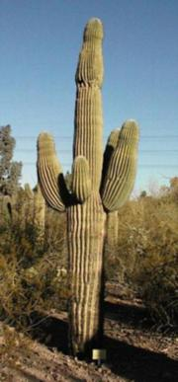
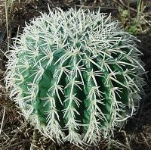
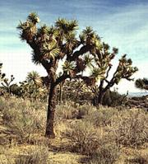
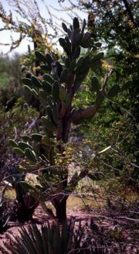
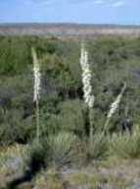
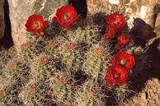
Desert Plants
Barrel Cactus
Joshua Tree
Saguaro Cactus
Soaptree Yucca
Crimson Hedgehog
Pancake Prickly Pear

Slide 20
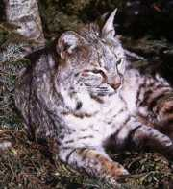
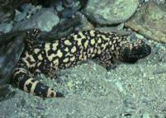
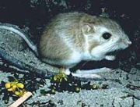
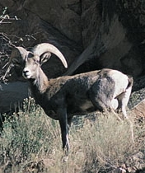
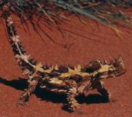

Desert Animals
Gila Monster
Kangaroo Rat
Bobcat
Desert Tortoise
Thorny Devil
Desert Bighorn Sheep

Slide 21
Grasslands
Dominated by climax communities of grasses.
Temperate and Tropical regions
Precipitation: 25 – 75 cm per year
Found all around the world with different names:
North America called Prairies
Asia called Steppes
Africa called Savannas
South America called Pampas

Slide 22
Grasslands perfect for growing wheat, rye, oats, barley, and corn.
Grasslands also used to raise sheep and cattle.

Slide 23






Grassland – Steppes Plant & Animal Life
Fringed Sagebush
Tumbleweed
Rhubarb
Corsac Fox
Saiga Antelope
Northern Lynx

Slide 24







Northern America Prairie Plants & Animals
Purple Cone Flower
Indian Grass
Buffalo Grass
Milkweed
Bumblebee
Prairie Dog
Badger

Slide 25



Pampas Plant and Animals
Pampas Grass
Greater Rhea
Geoffory’s Cat

Slide 26








Savanna Plant and Animals
Baobab Tree
Elephant Grass
Kangaroo Paw
Mankettia Tree
Lion
African Elephant
Koala Bear
Baboon

Slide 27
Aquatic Biomes

Slide 28
Freshwater Ecosystems
Include flowing water such as rivers and streams.
Standing water such as lakes, ponds, and wetlands.
4 factors that determine which species can survive are: Water Temp, Sunlight, Dissolved Oxygen, and Amount of Salt.

Slide 29
Rivers and Streams
Flowing freshwater environments.
Small brooks to large rivers.
The faster the river flows the more oxygen content there is in the water.
Most nutrients are washed into the water from the land it flows through.
Humans use for recreations: fishing, swimming, skiing, etc.
Once considered a free place to dump sewage.

Slide 30




Rivers and Streams
River
River
Grass Bank Stream
Waterfall Stream

Slide 31
Lakes and Ponds
A low place that fills with water over time or water from an overflowing stream.
Water hardly moves.
Contains more plant life than flowing water.
Lakes are larger and deeper than ponds.
Pond water is warmed by the sunlight and support plant ( algae and plankton) and animal life.
Deeper lakes support life longer.

Slide 32




Lakes and Ponds
Lake
Lake
Pond
Pond

Slide 33
Wetlands
Regions that are wet for all or most of the year
Found in regions that lie between landmasses and water.
Other names: swamps, bogs, and fens
Very fertile
Animals: beavers, muskrats, alligators, bog turtles.
Once thought of as useless, but are now being restored for their valuable resources.

Slide 34






Wetlands
Muskrat
Bog Turtle
Beavers

Slide 35
Salt Water Ecosystems

Slide 36
2 Zones of the Ocean
Lighted Zone – upper 200 m, sunlight penetrates the water. Home of plankton.
Dark Zone – Below 200 m, sunlight does not penetrate this water. Animals feed or organisms that float down or on each other.

Slide 37


Slide 38
Coral Reefs
One of the most diverse ecosystem in the world.
Formed over long periods of time.
Formed by calcium carbonate skeletons secreted by animals called coral.
When coral dies their skeletons remain.

Slide 39


Slide 40
The Ocean
Intertidal Zone – is the portion of the shoreline that is covered with water at high tide and exposed to the air during low tide- Called the Seashore – Contains- sea grasses, periwinkle snails, herons, sea stars, anemones, clams, crabs, snails, and conchs
Neritic Zone – Moves away from the shore, water is warm and receives a lot of sunlight. Contains seaweed, corals, sea turtles, fishes, sponges, and dolphins

Slide 41
The Ocean Zone
The Oceanic Zone – Sea floor drops sharply, Plankton is found near the surface, contains fishes, whales, sharks, squids, glow fish
Benthic Zone – Is the ocean floor, deepest parts do not get any sunlight, very cold, animals: fishes, worms, crabs, bacteria, sea urchins – some animals get energy from thermal vents

Slide 42



Slide 43
Estuaries
The area where a river meets an ocean and contains a mixture of freshwater and salt water.
Also called bays, lagoons, harbors, inlets, and sounds.
Extremely fertile because the freshwater brings tons of nutrients.

Slide 44
Estuary Life
Many species of algae, salt-tolerant grasses, shrimp, crabs, clams, oysters, snails, worms, and fish.
Estuaries provide much of the seafood consumed by humans.

Slide 45


