Slide 1
Assistive and Adaptive Technology

Slide 2
Adaptive technologies are a part of assistive technology
ogy
Adaptive Technology
Assistive Technology

Slide 3
Assistive Devices
Any object or system that increases or maintains the capabilities of people with disabilities.
These devices were originally designed for the general public, but can be used by people with disabilities as well.
Examples: crutches, contact lens, hearing aids, wheel chairs, hand held magnifiers, braces, canes, walkers, calculator

Slide 4
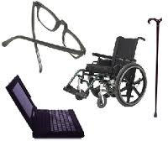
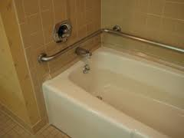
Assistive Devices

Slide 5
Adaptive Devices
An item that is specifically designed for persons with disabilities; devices which would seldom be used by non-disabled persons.
Examples: cochlear implants, mechanical organs, artificial limbs, gene therapy, hand controlled car, Braille books, voice activated computer

Slide 6
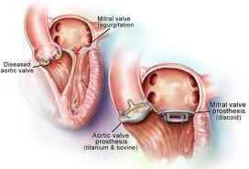
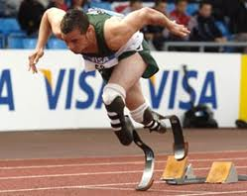
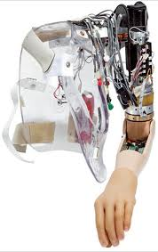
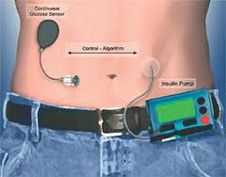
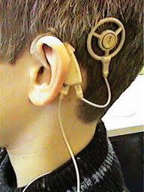
Adaptive Devices

